Slide 1
Module 3 Homework
Due: February 17, 2022 at 4:00PM
For this assignment you are to perform an EDA and generate an EDA report following the process and example presented in class (Employee Attrition)
For this assignment, you will be working with a database on absenteeism at work from July 2007 to July 2010 at a courier company in Brazil.
You can download the dataset and view information about it here: https://archive.ics.uci.edu/ml/datasets/Absenteeism+at+work

Slide 2
Module 3 Homework
Due: February 17, 2022 at 4:00PM
Your EDA report should be in the same format as presented in class and you should use the remainder of this PowerPoint file as a template.
You may add as many pages as necessary to complete the report.
As always, when completed, save this PPT to a PDF file and upload it to GradeScope (marking your submission with the corresponding outline of graded items in GradeScope)
As noted in class, there are many possible responses. You will get full credit so long as you explain any decisions that you make in the process.

Slide 3
Absenteeism
EDA Report

Slide 4
Sample Project Plan
Predicting Absenteeism Attrition
Business Objectives
As we all know, company do not like employee absent for the work. This action will harm and delay the work of the whole company, even break contract because of employee absent. The objective for this assignment will be which parameter related employee absent for work.
Data Sources
Absenteeism: Dataset with 21 attributes regarding 740 absentee instances
https://archive.ics.uci.edu/ml/datasets/Absenteeism+at+work

Slide 5
Initial Data Review and Cleanup

Slide 6
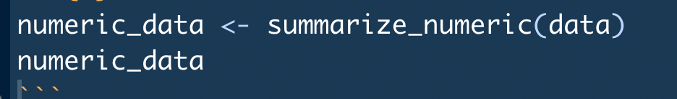
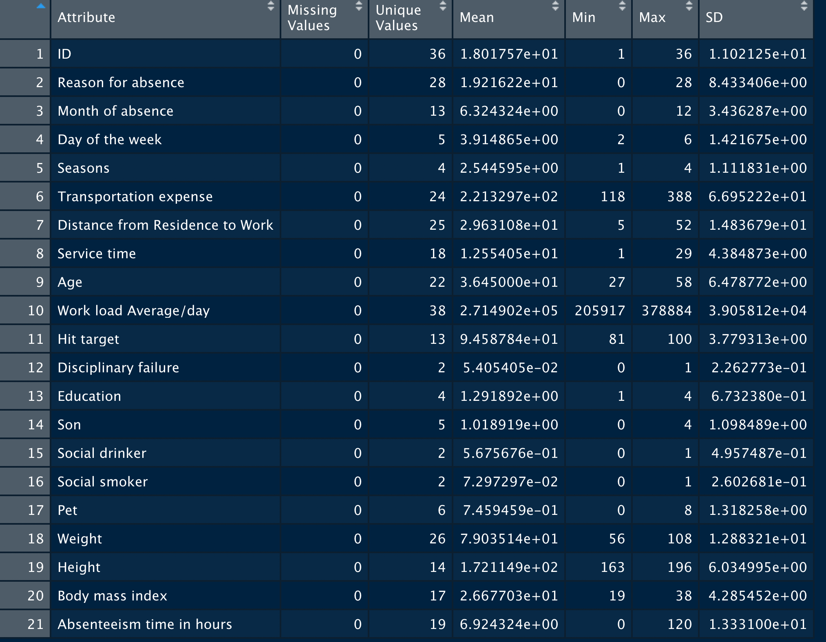
Initial Data Review and Cleanup - Numerics
Use the function to see is this database clean or not

Slide 7
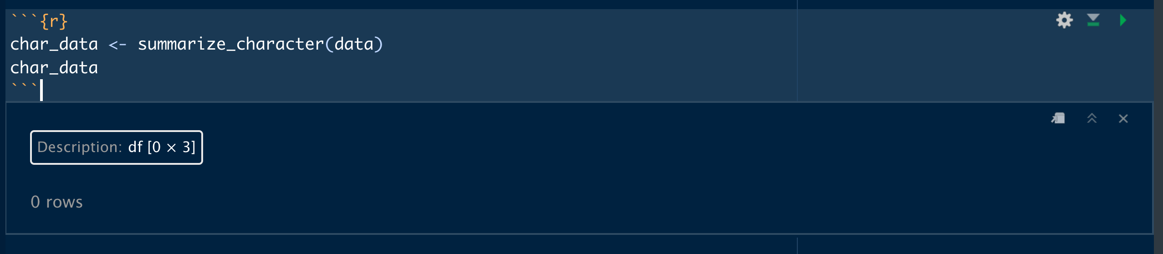
There is no character in this database

Slide 8
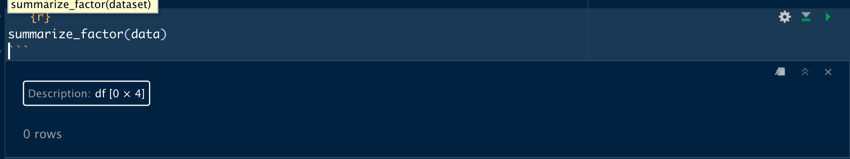
There is no factor in this database

Slide 9
Initial Observations
Data appears very clean
No missing values
Data appears to contain a unique key: ID. Useful for uniquely identifying individual employees and for joining to additional datasets but will be removed from the analytic dataset for the purposes of this study.
21 numeric variables
Most numeric attributes appear to be categories
0-character variables
All variables are numeric attributes, because this database use number to represent character, such as 1 for ”Yes”, 2 for “No”. The database comes with a discerption to help you to understand what means is represented by the number.

Slide 10
Convert to Measures/Factors and Logically Group Attributes

Slide 11
Numeric Variables Used as Factors (From Data Source Description)
Reason for absence 1. Certain infectious and parasitic diseases
2. Neoplasms 3. Diseases of the blood and blood-forming organs and certain disorders involving the immune mechanism 4. Endocrine, nutritional and metabolic diseases 5. Mental and behavioral disorders
6. Diseases of the nervous system
7. Diseases of the eye and adnexa
8. Diseases of the ear and mastoid process
9. Diseases of the circulatory system
10. Diseases of the respiratory system
11. Diseases of the digestive system
12. Diseases of the skin and subcutaneous tissue
13. Diseases of the musculoskeletal system and connective tissue
14. Diseases of the genitourinary system
15. Pregnancy, childbirth and the puerperium
16. Certain conditions originating in the perinatal period
17. Congenital malformations, deformations and chromosomal abnormalities
18. Symptoms, signs and abnormal clinical and laboratory findings, not elsewhere classified
19. Injury, poisoning and certain other consequences of external causes
20. External causes of morbidity and mortality
21. Factors influencing health status and contact with health services.

Slide 12
Sample Exploratory Data Analysis (EDA) Document
Numeric Variables Used as Factors (From Data Source Description)
Education 1 'Below College' 2 'College' 3 'Bachelor' 4 'Master' 5 'Doctor'
EnvironmentSatisfaction 1 'Low' 2 'Medium' 3 'High' 4 'Very High'
JobInvolvement 1 'Low' 2 'Medium' 3 'High' 4 'Very High'
JobSatisfaction 1 'Low' 2 'Medium' 3 'High' 4 'Very High'
PerformanceRating 1 'Low' 2 'Good' 3 'Excellent' 4 'Outstanding'
RelationshipSatisfaction 1 'Low' 2 'Medium' 3 'High' 4 'Very High'
WorkLifeBalance 1 'Bad' 2 'Good' 3 'Better' 4 'Best'

Slide 13
Numeric Variables Used as Factors (From Data Source Description)
Day of the week
2 ‘Monday’
3 ‘Tuesday’
4 ‘Wednesday’
5 ‘Thursday’
6 ‘Friday’
Disciplinary failure
1 ‘yes’
0 ‘no’
Education
1 ‘high school’
2 ‘graduate’
3 ‘postgraduate’
4 ‘master and doctor’
Social drinker
1 ‘yes’
0 ‘no’
Social smoker
1 ‘yes’
0 ‘no’

Slide 14
Numeric Variables Used as Factors (From Data Source Description)
Day of the week
2 ‘Monday’
3 ‘Tuesday’
4 ‘Wednesday’
5 ‘Thursday’
6 ‘Friday’
Disciplinary failure
1 ‘yes’
0 ‘no’
Education
1 ‘high school’
2 ‘graduate’
3 ‘postgraduate’
4 ‘master and doctor’
Social drinker
1 ‘yes’
0 ‘no’
Social smoker
1 ‘yes’
0 ‘no’

Slide 15
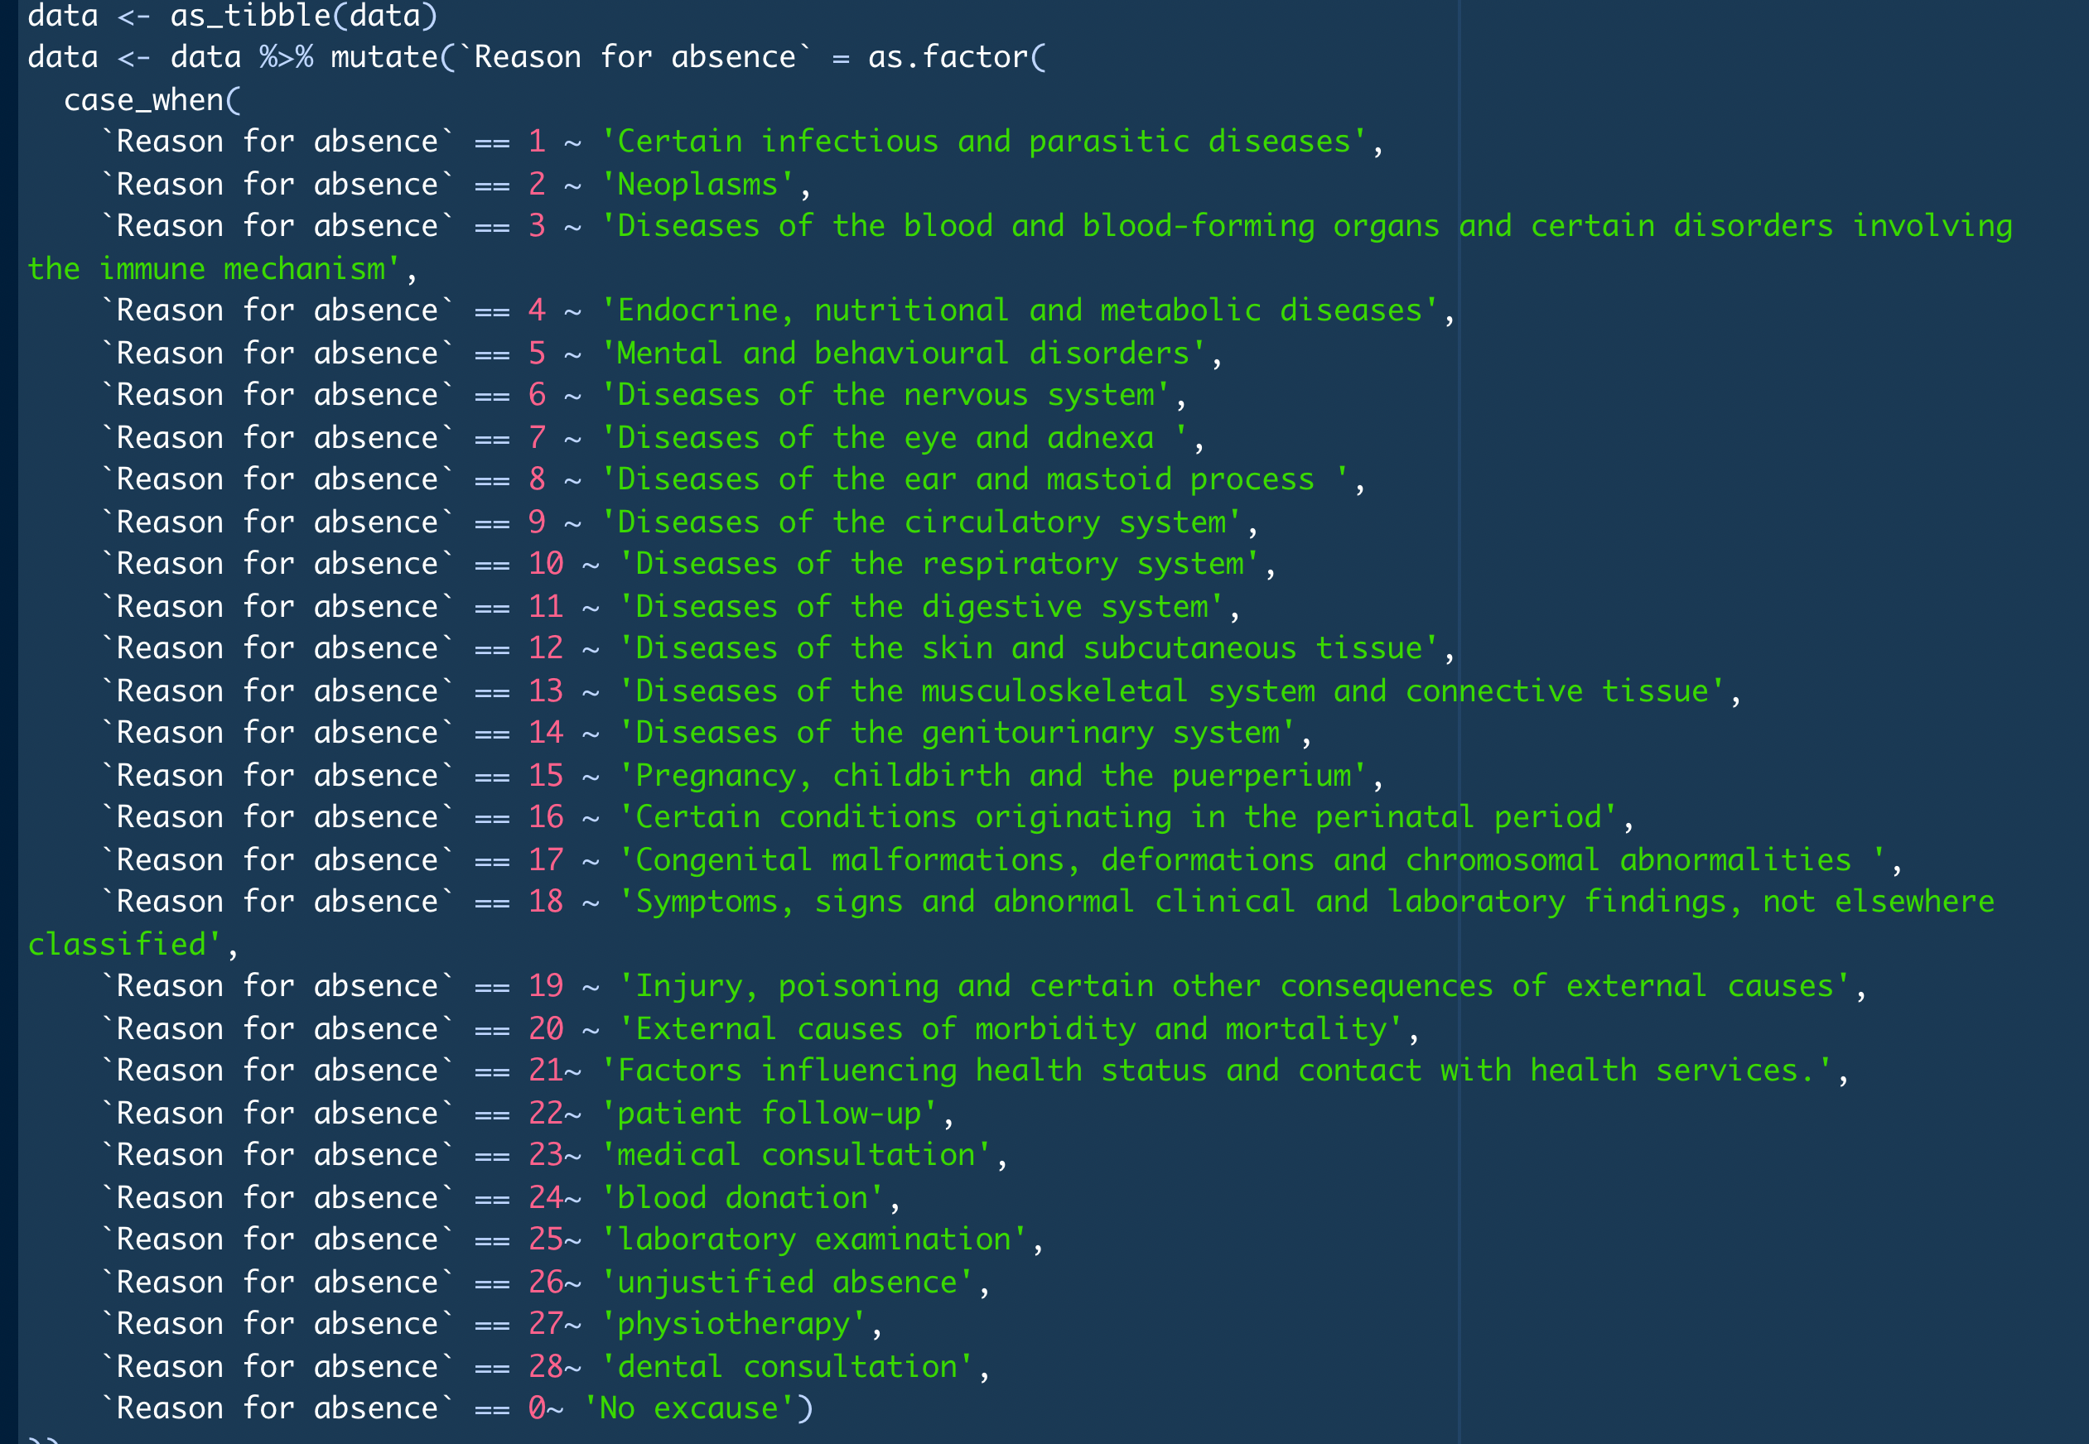
I use mutate and case when to replace the number to factor

Slide 16
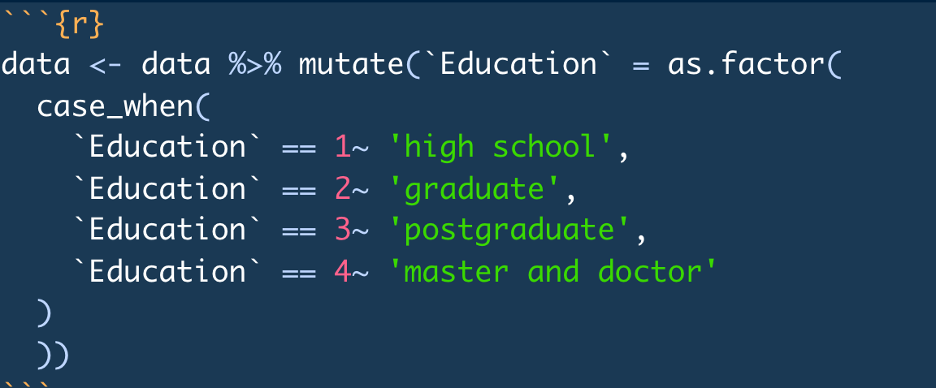
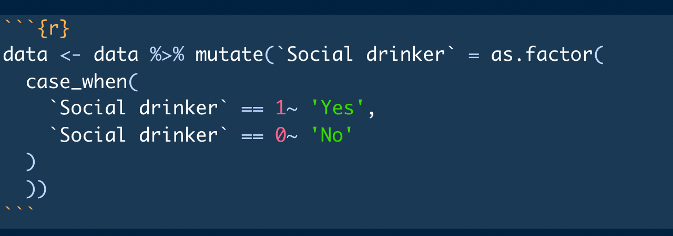

Slide 17
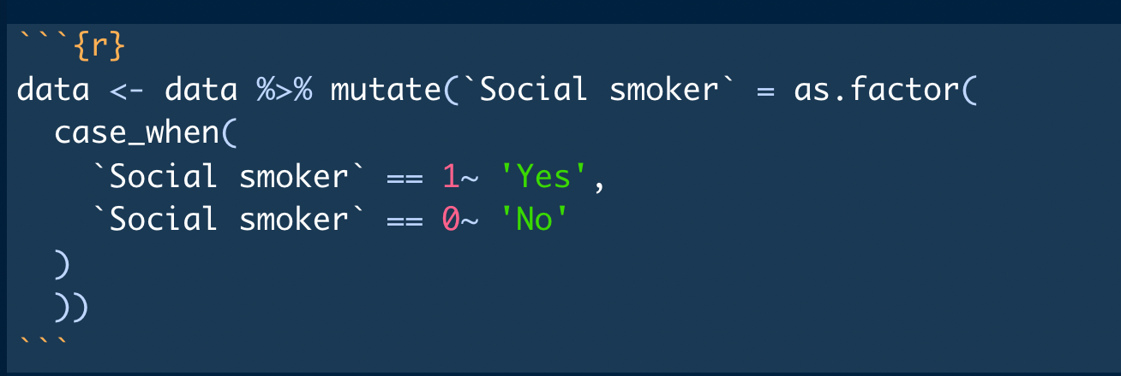
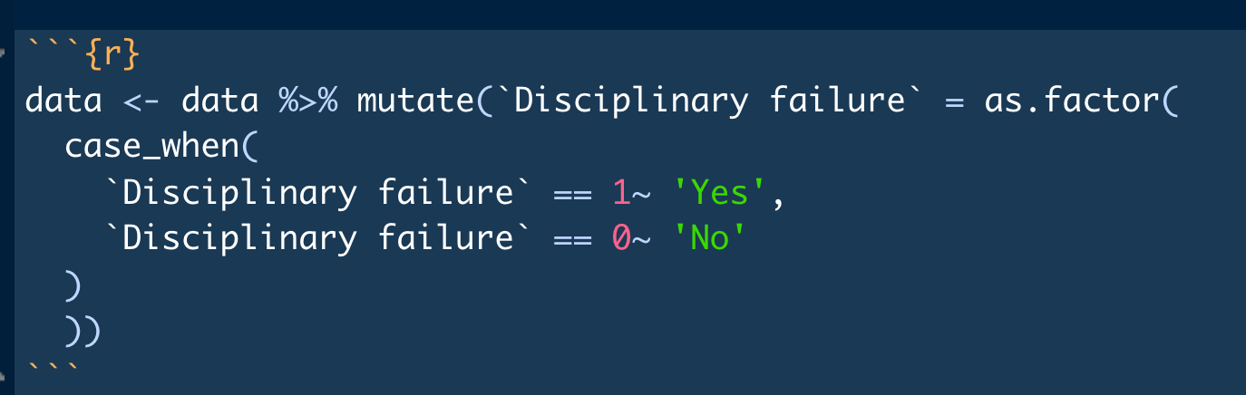

Slide 18
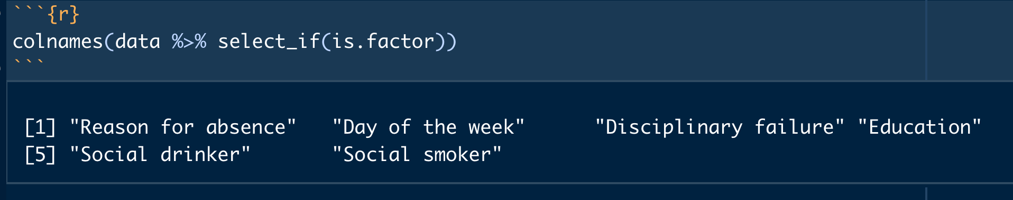
6 Categories (Factors):

Slide 19
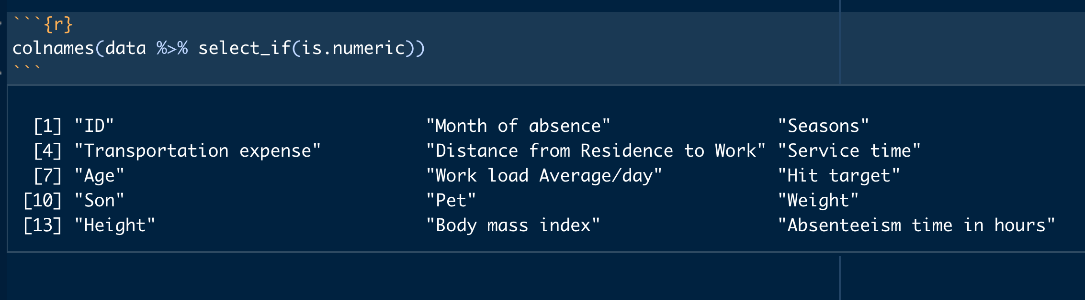
15 Numeric Variables (Measures):

Slide 20
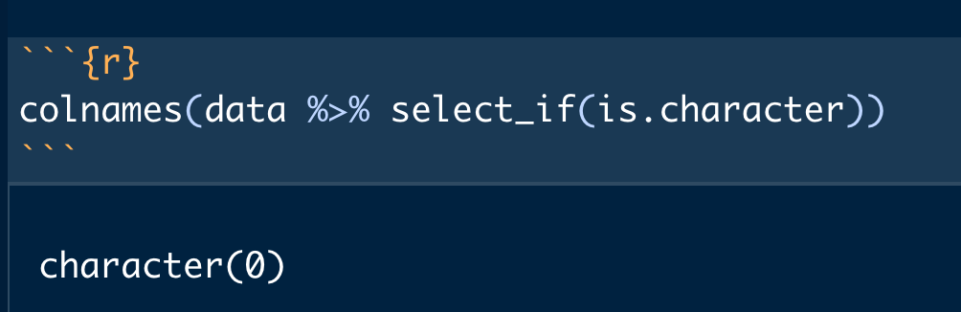
There is no character :

Slide 21
Summary of Attributes After Initial Analysis
Logical Groupings of Attributes
Numeric (15)
Absent date: Month of absence, Seasons
Personal information: Age, Son, Pet ,Weight , Height , Body mass index ,ID, Distance from Residence to Work, Transportation expense
Work information: Service time , Hit target , Work load Average/day,
Target: Absenteeism time in hours
Factors (6)
Absent date: Day of the week
Personal information: Social drinker , Social smoker, Education, Disciplinary failure
Reason for absent: Reason for absent

Slide 22
Univariate Analysis

Slide 23
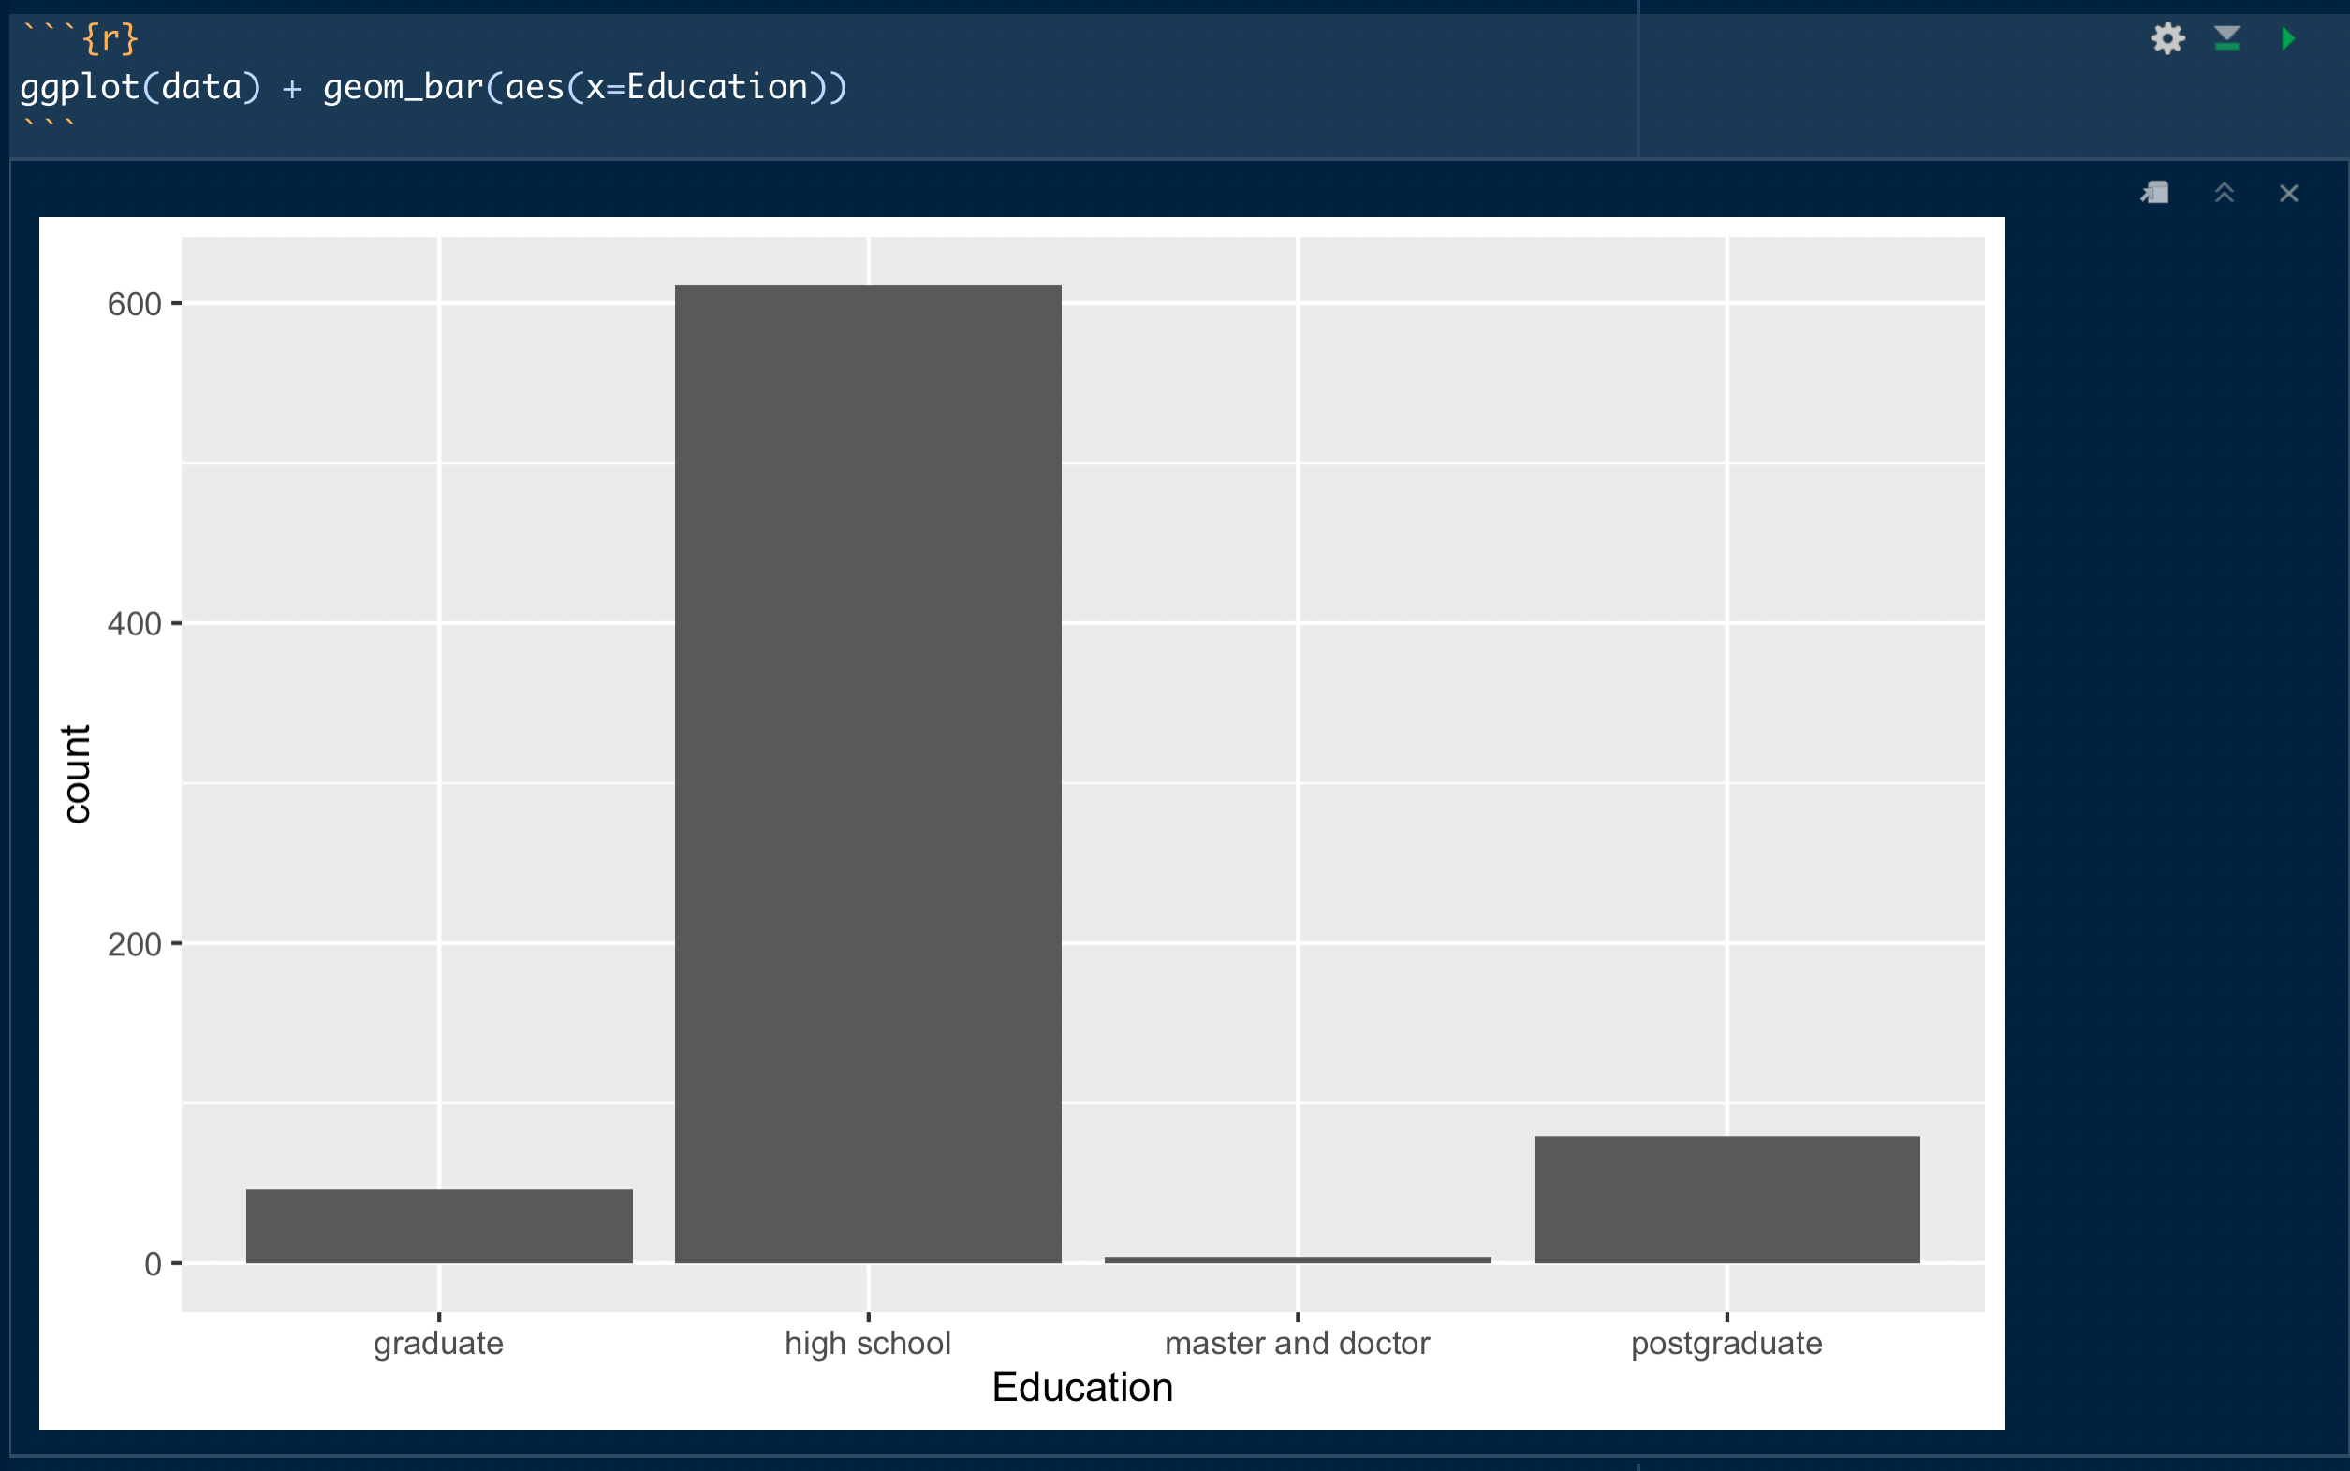
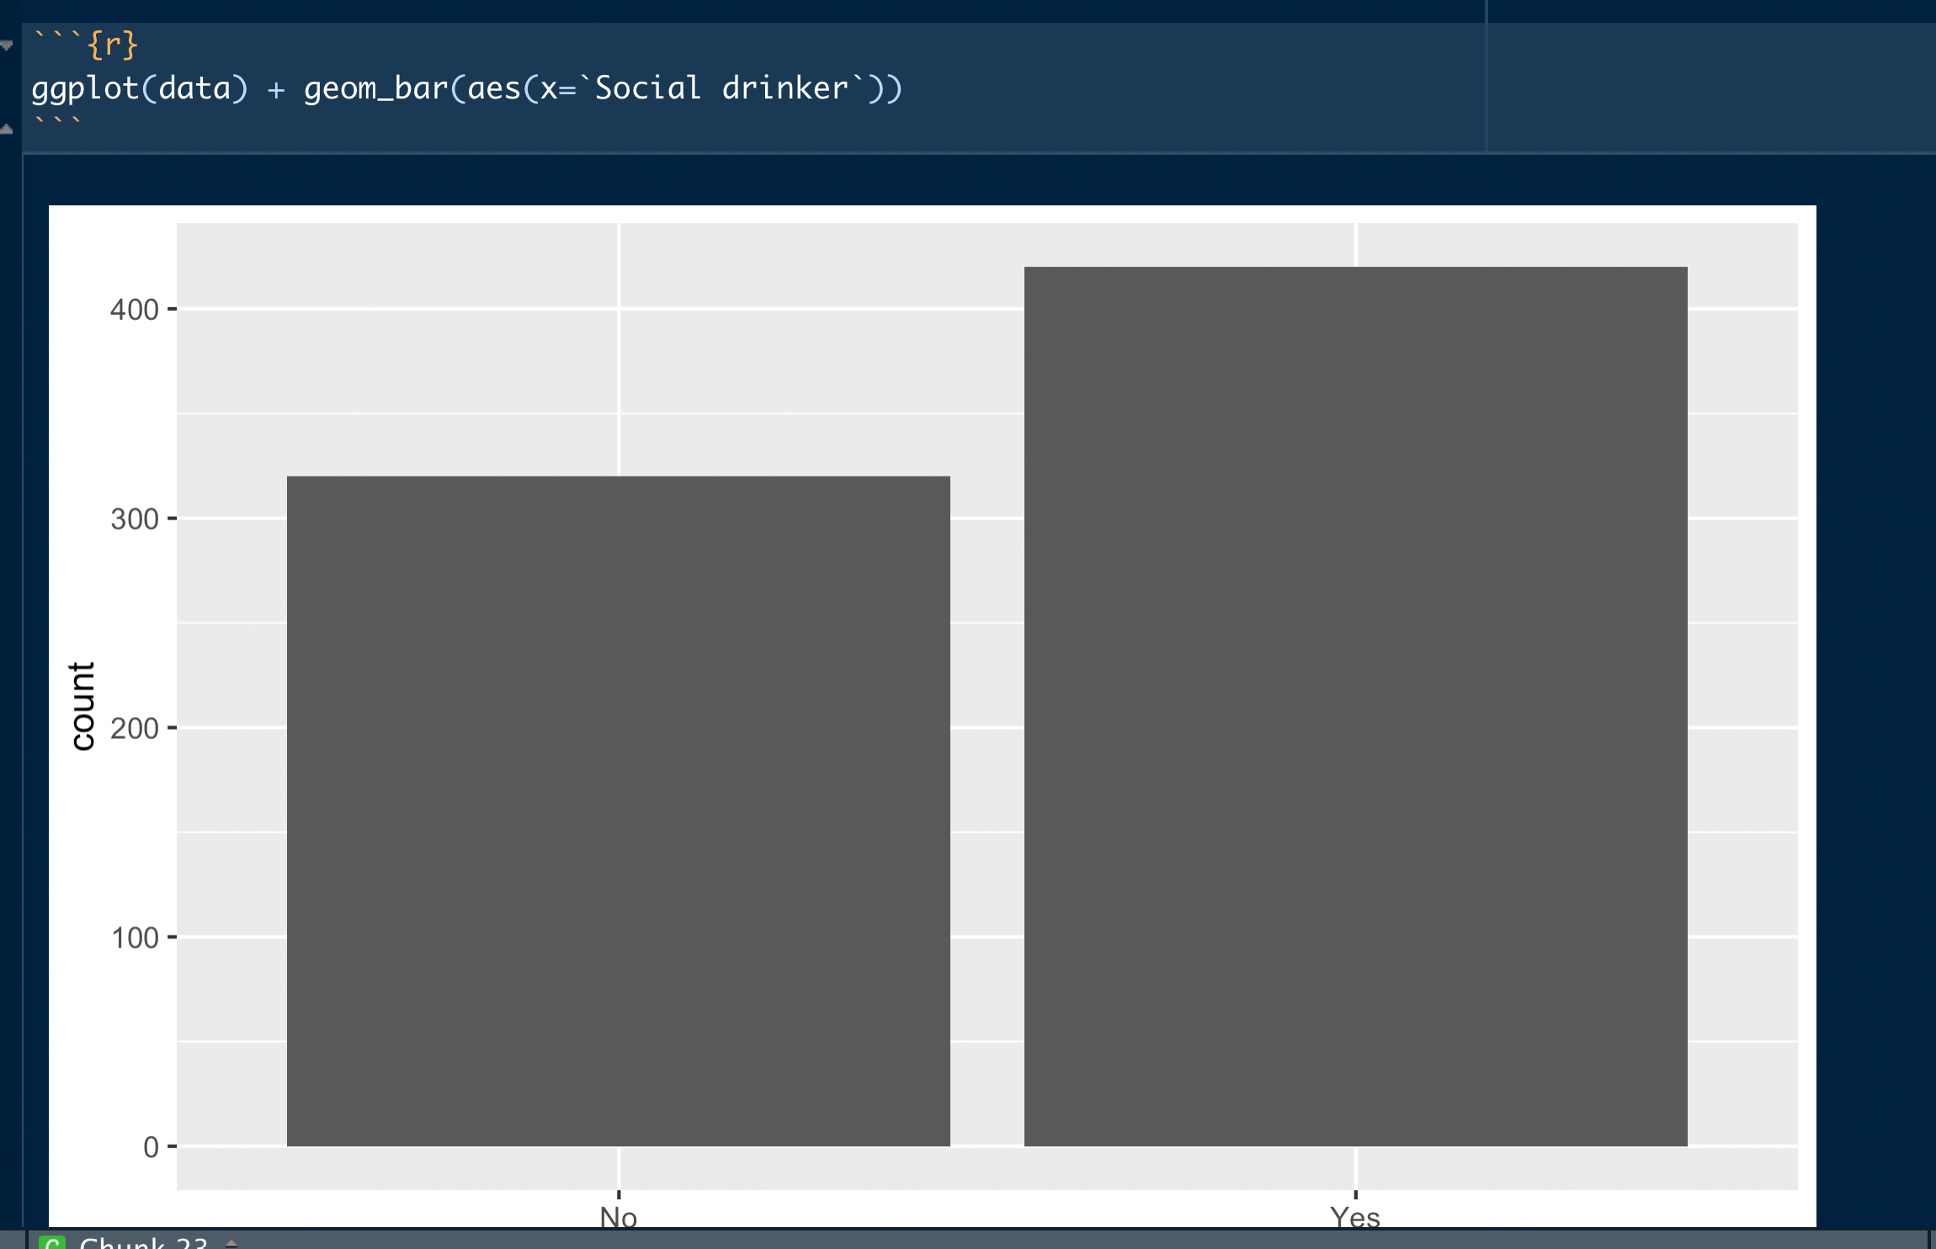
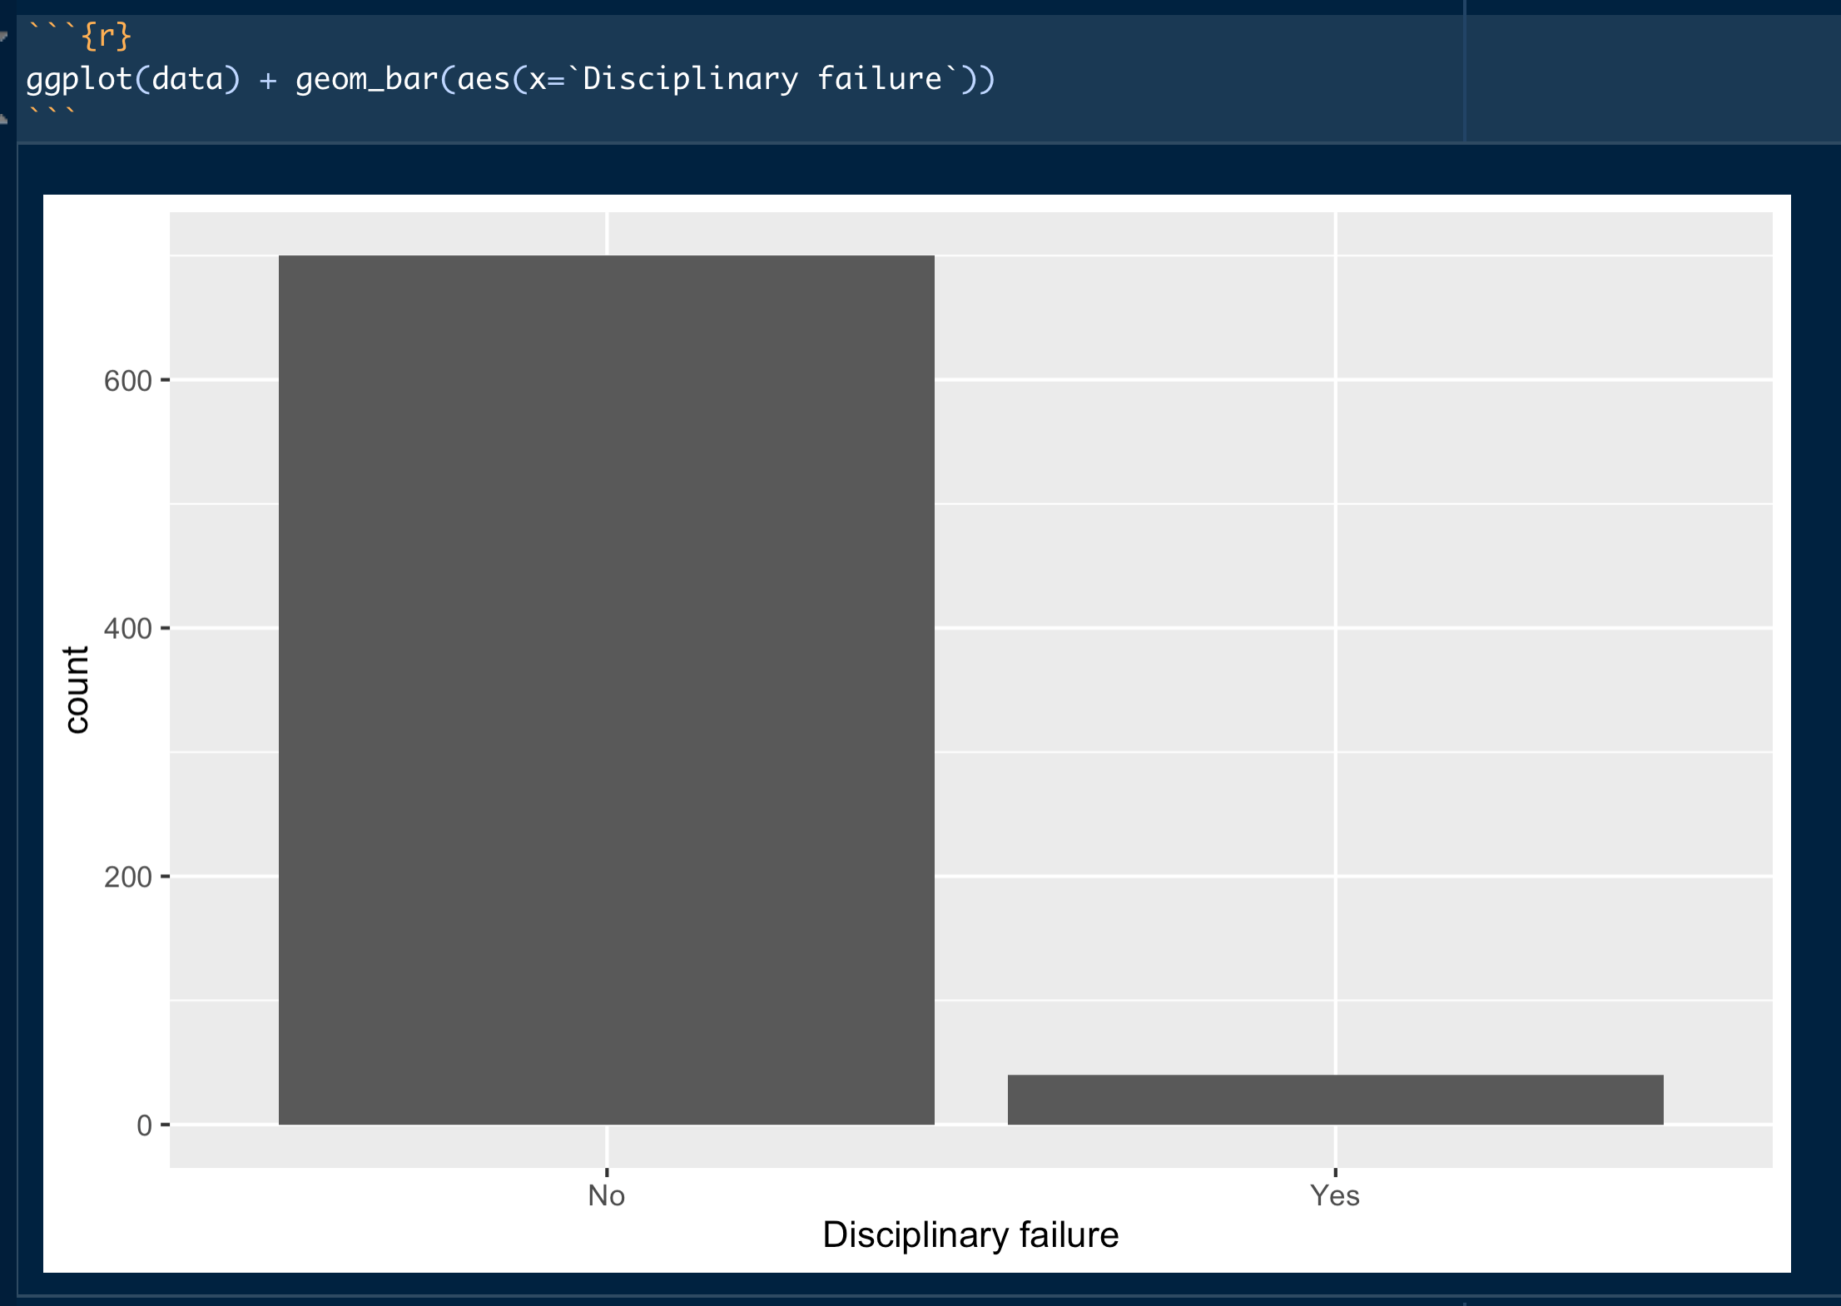
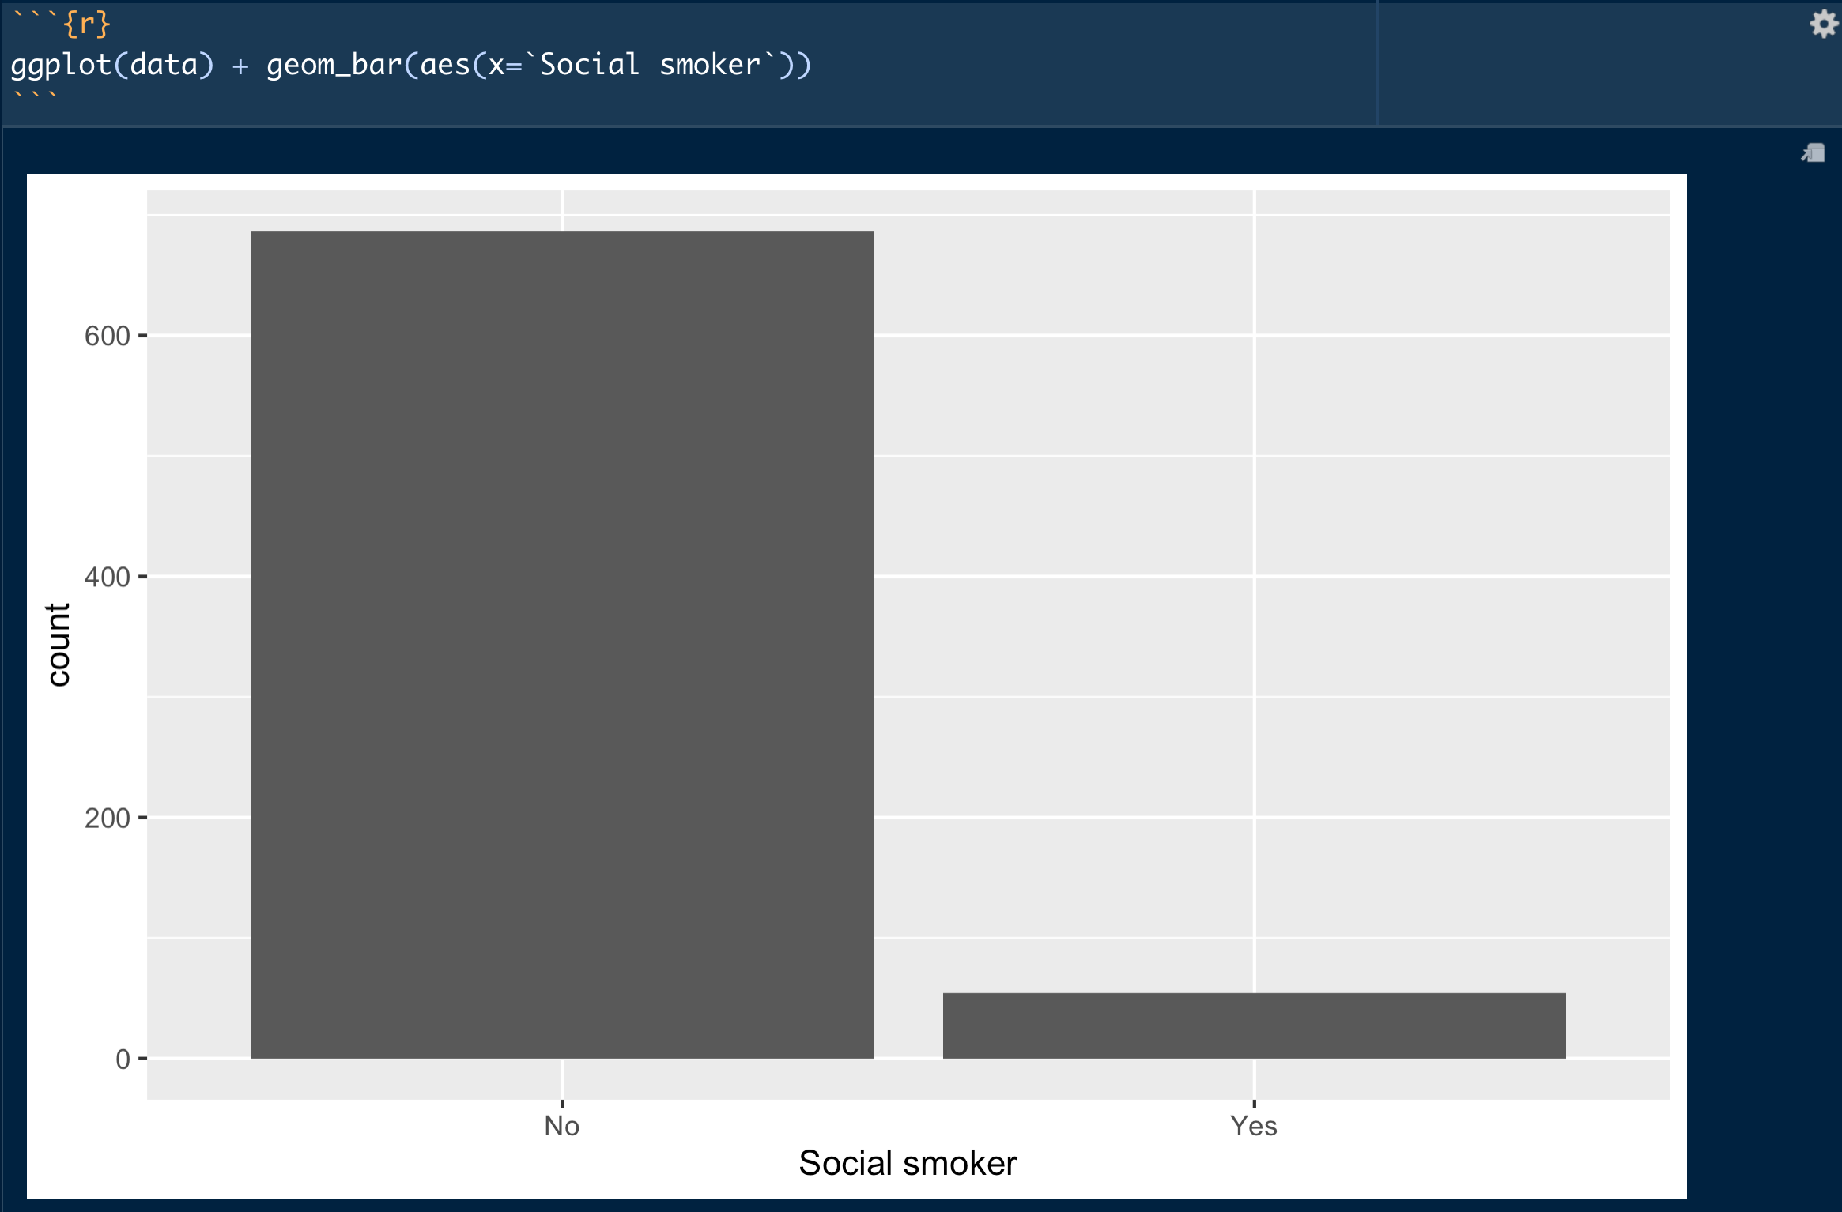
Univariate Summary of Factors –Personal information

Slide 24
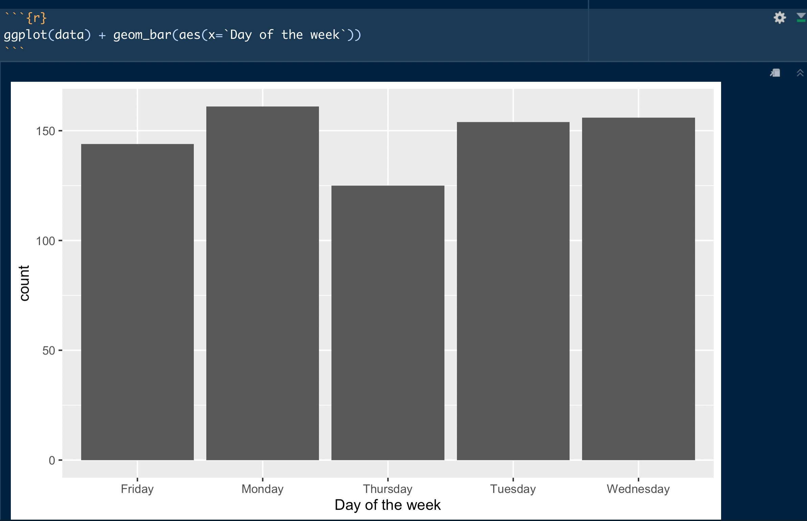
Univariate Summary of Factors – Day of week

Slide 25
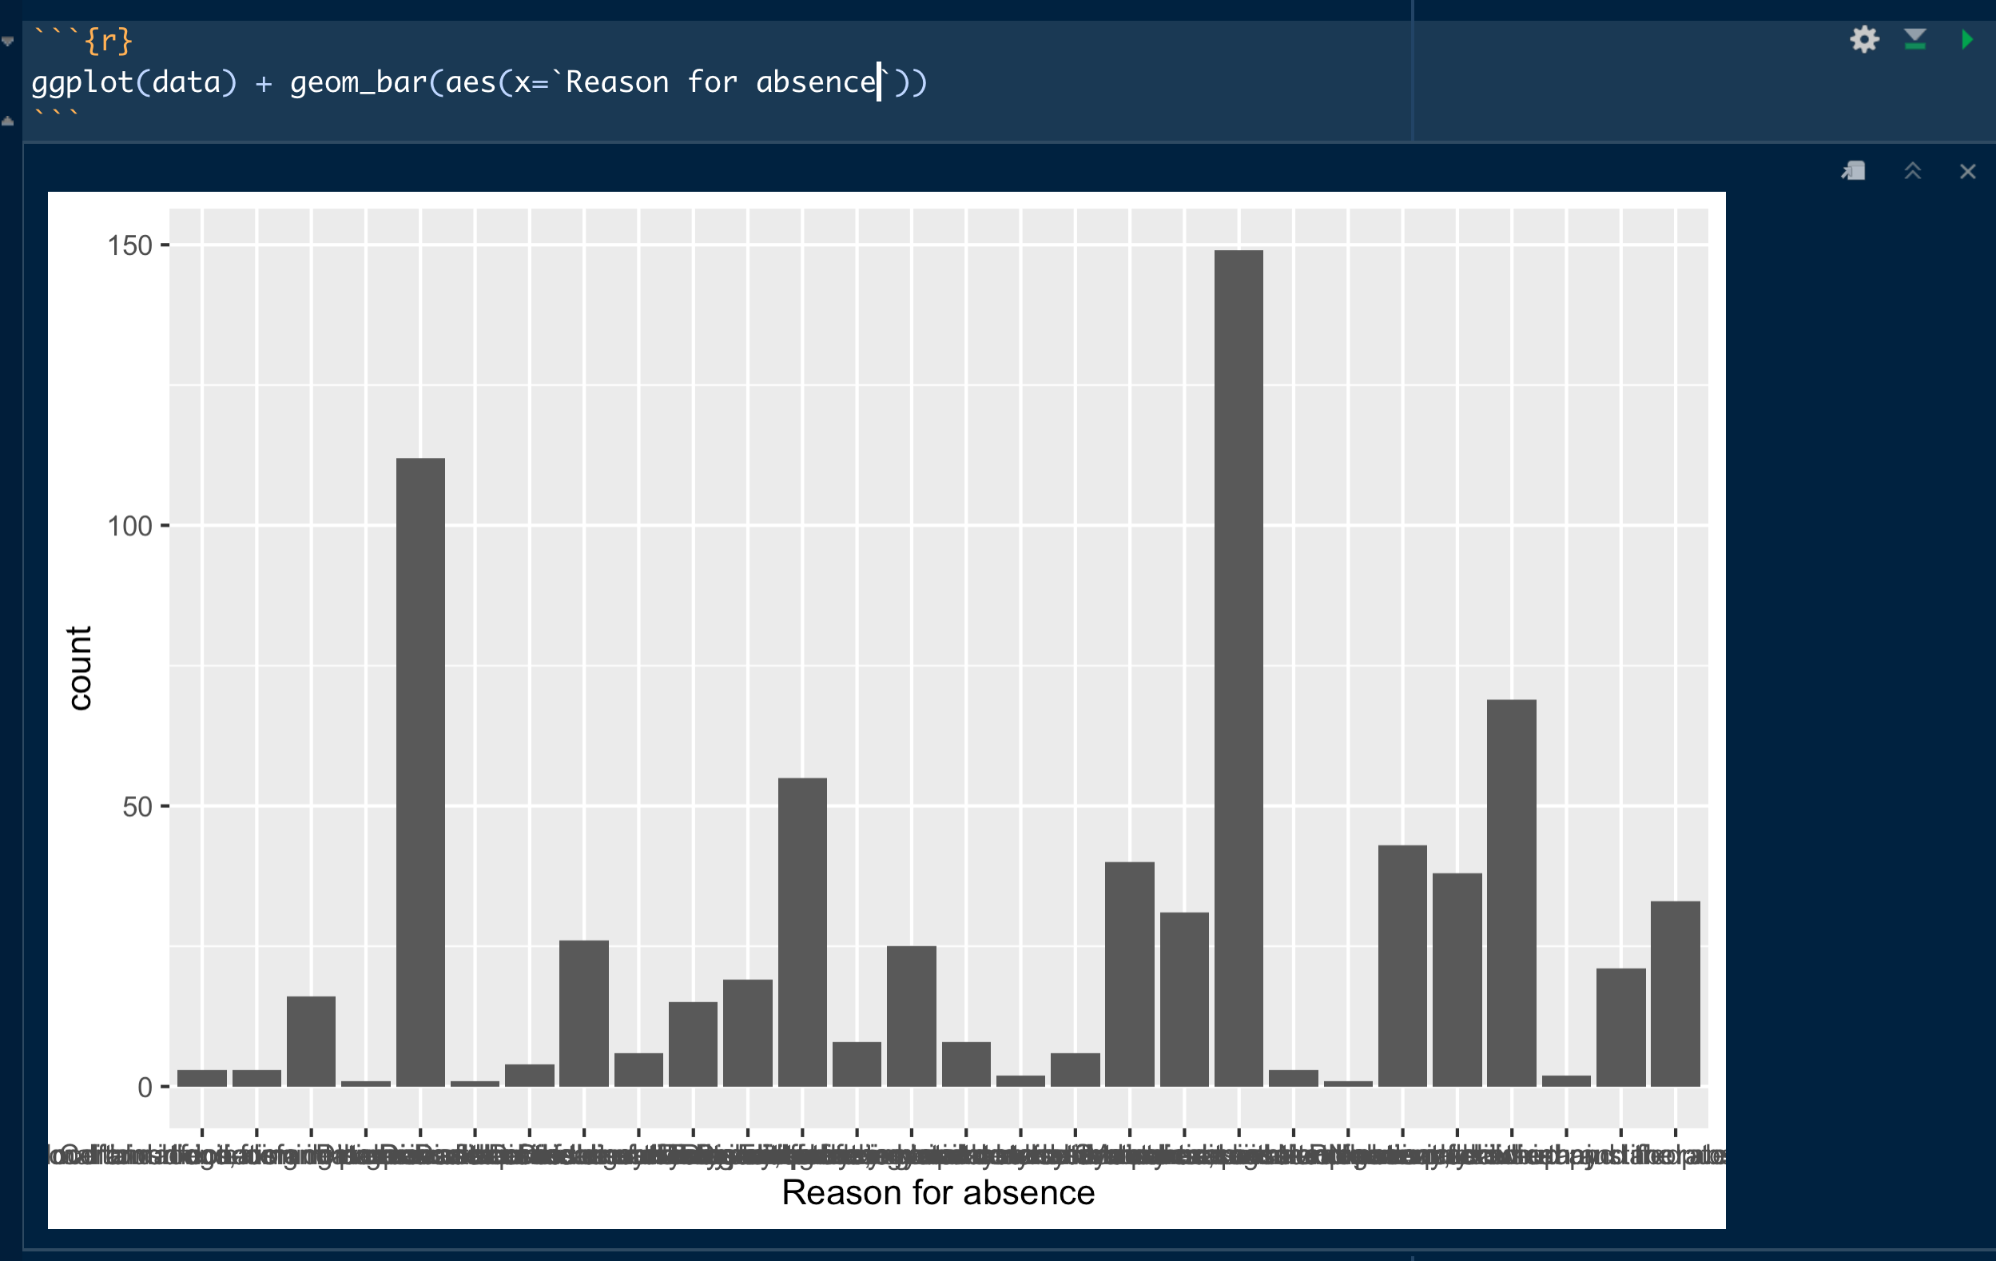
Univariate Summary of Factors – Reason for absent

Slide 26
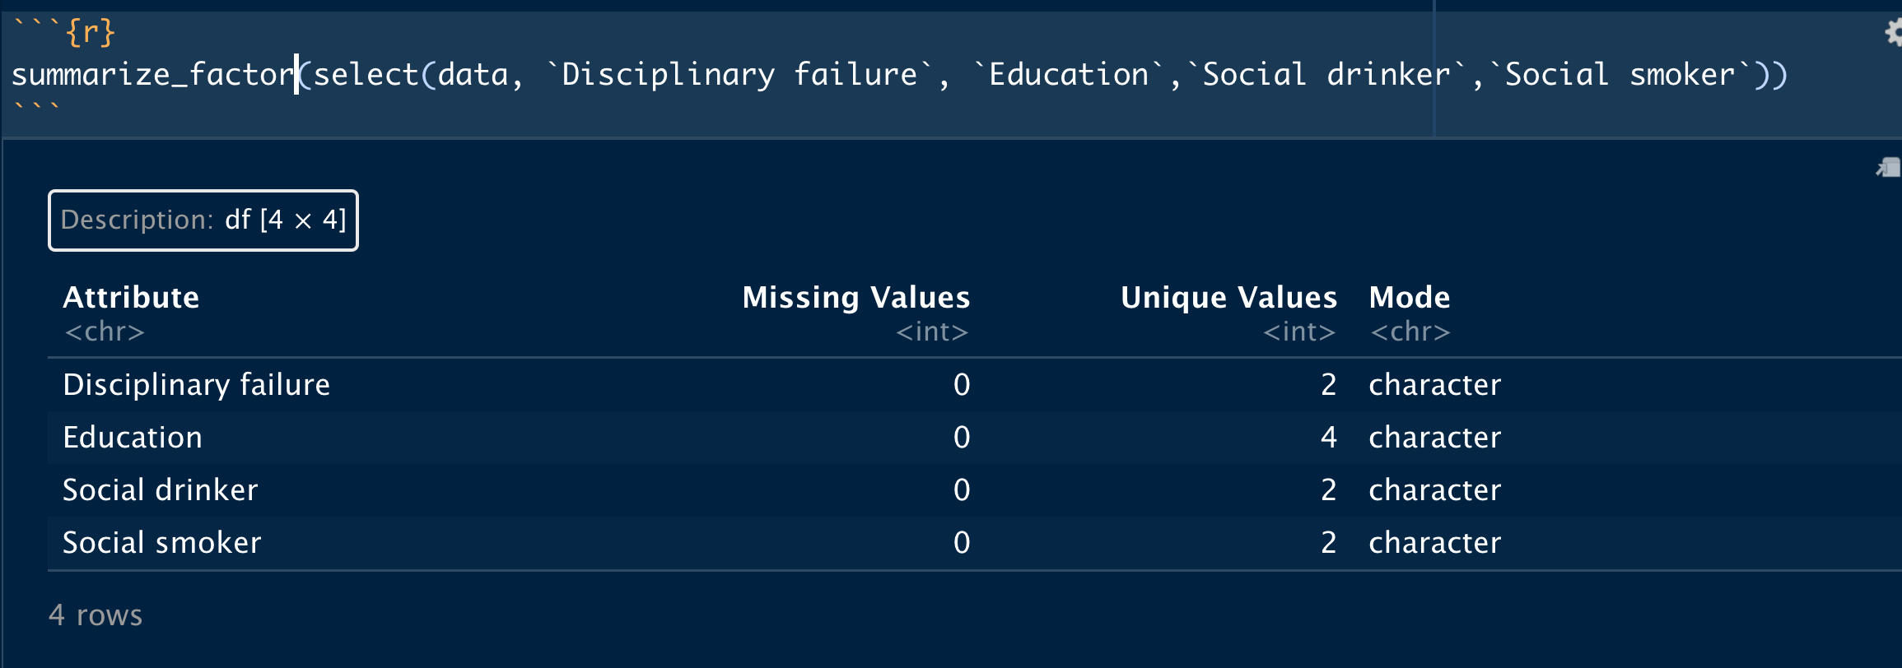
Summery for personal information

Slide 27
Univariate Summary of numeric –Absent date

Slide 28
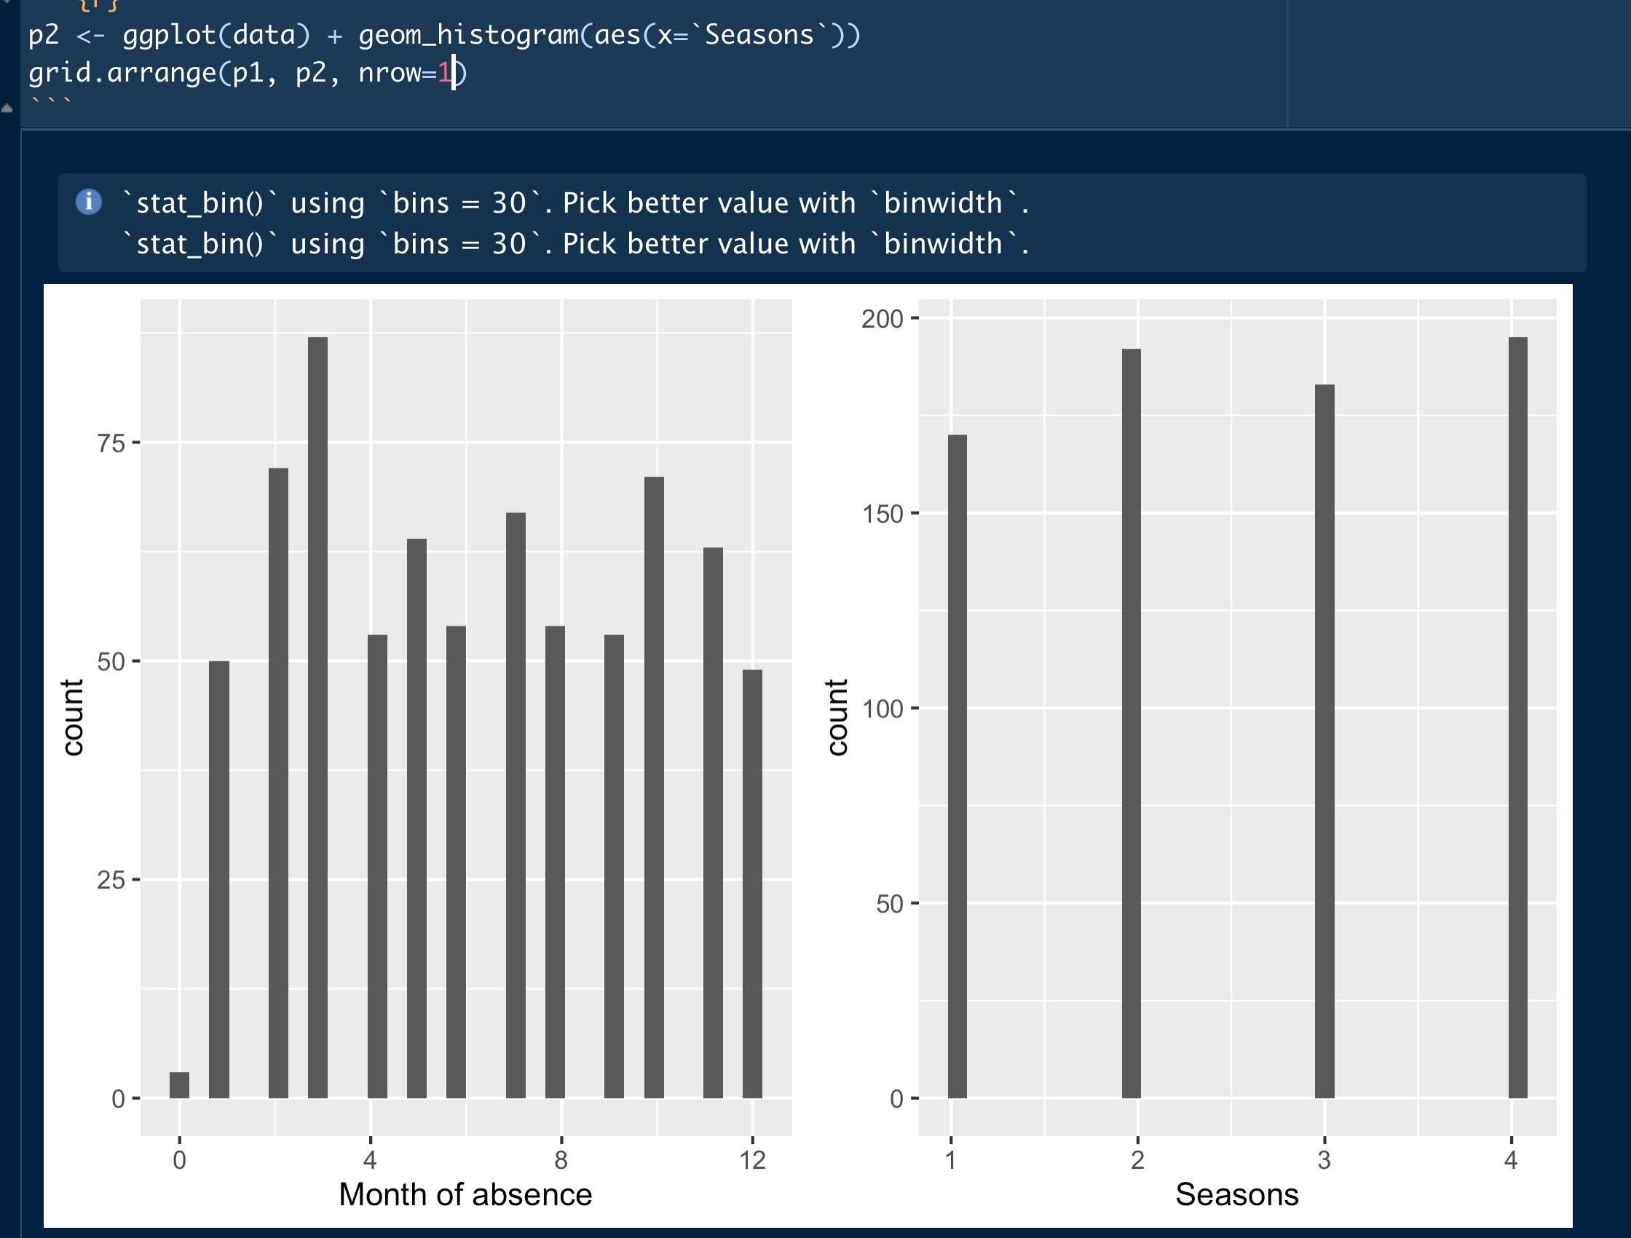
Absent date

Slide 29
Univariate Summary of numeric –Personal information

Slide 30
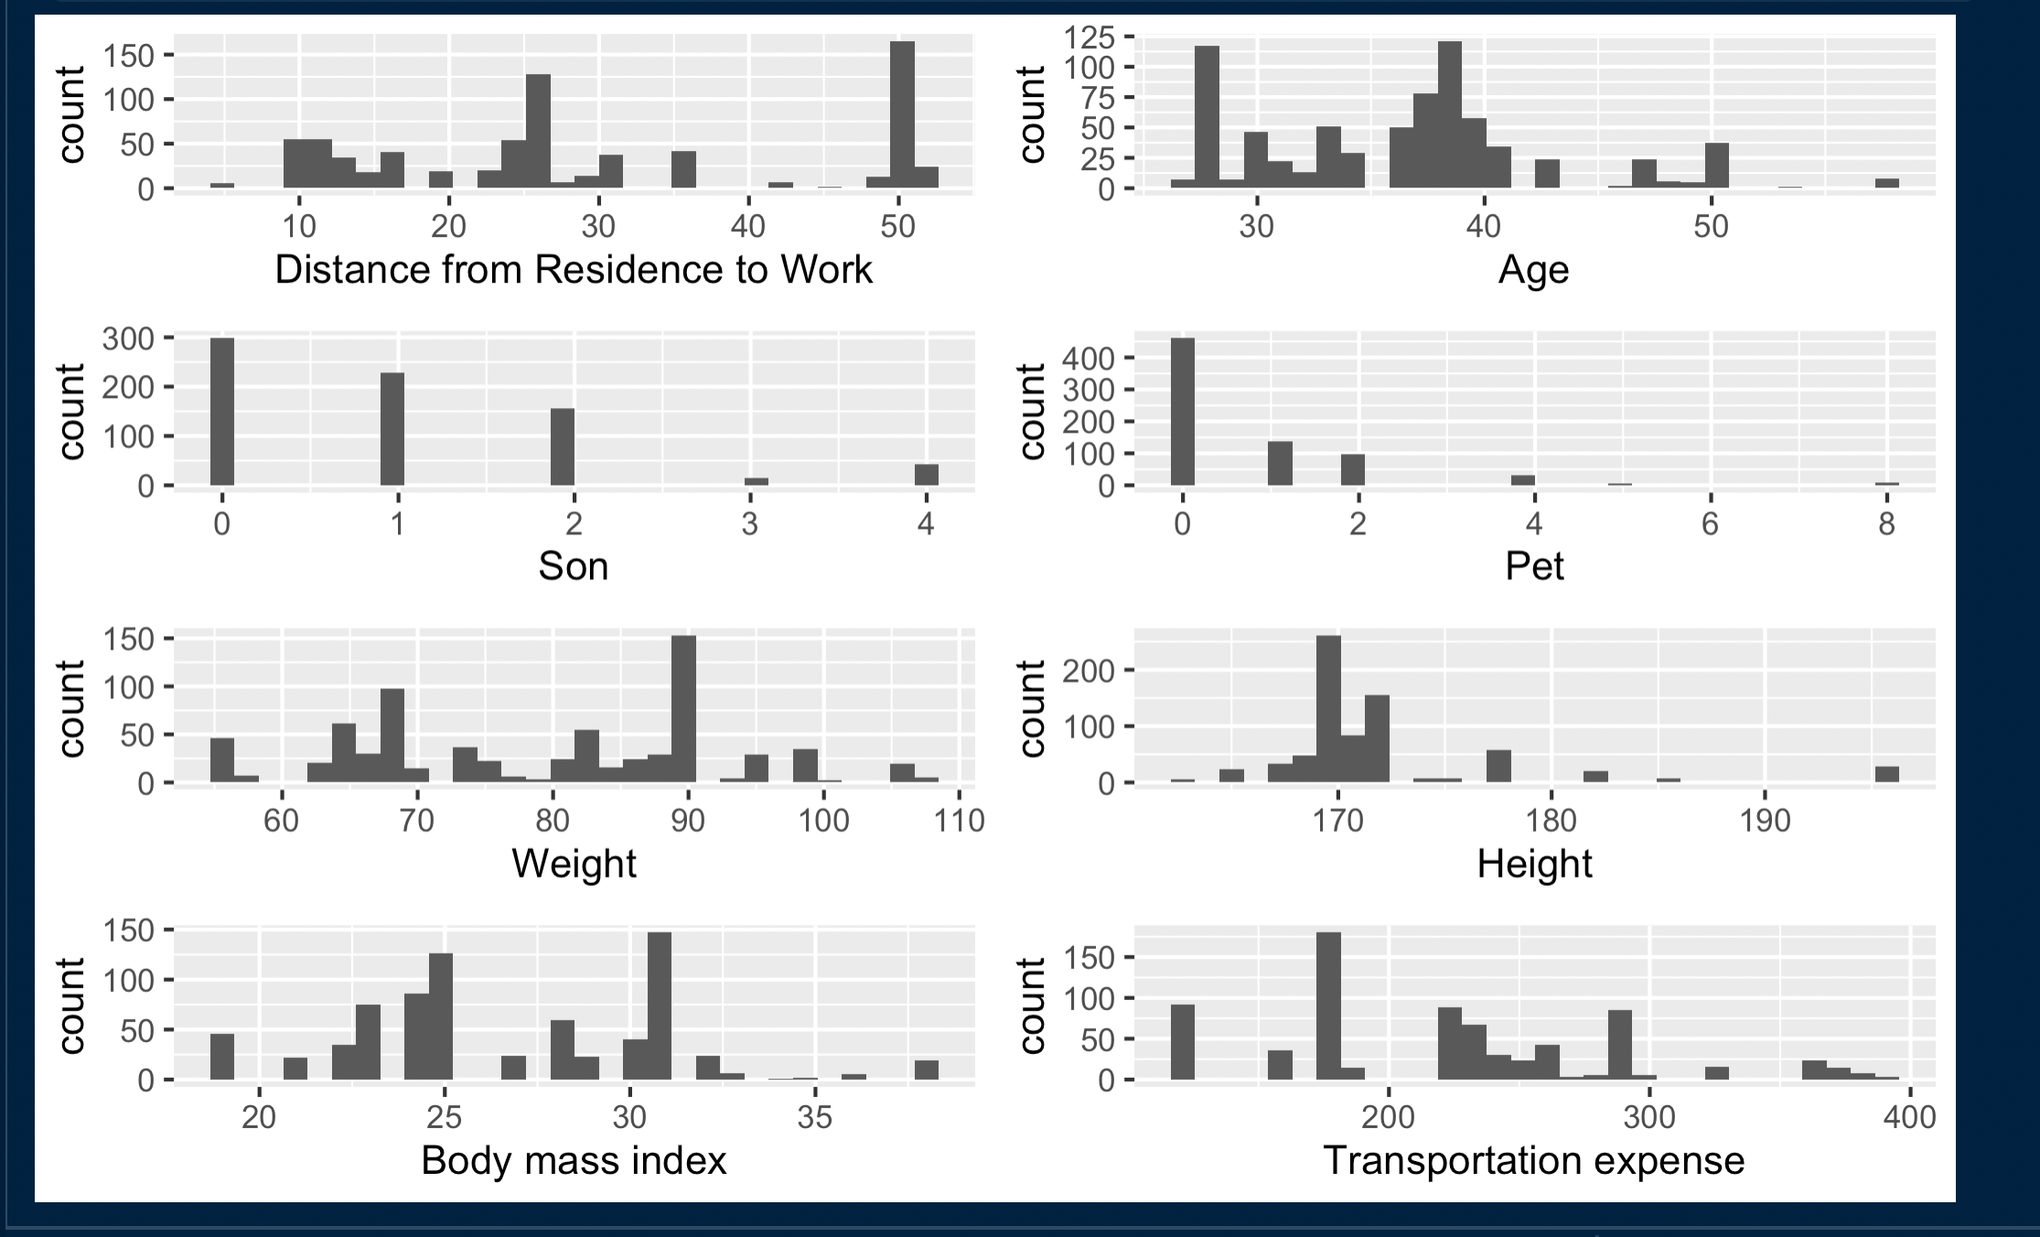
Personal information

Slide 31
Univariate Summary of numeric –Working information

Slide 32
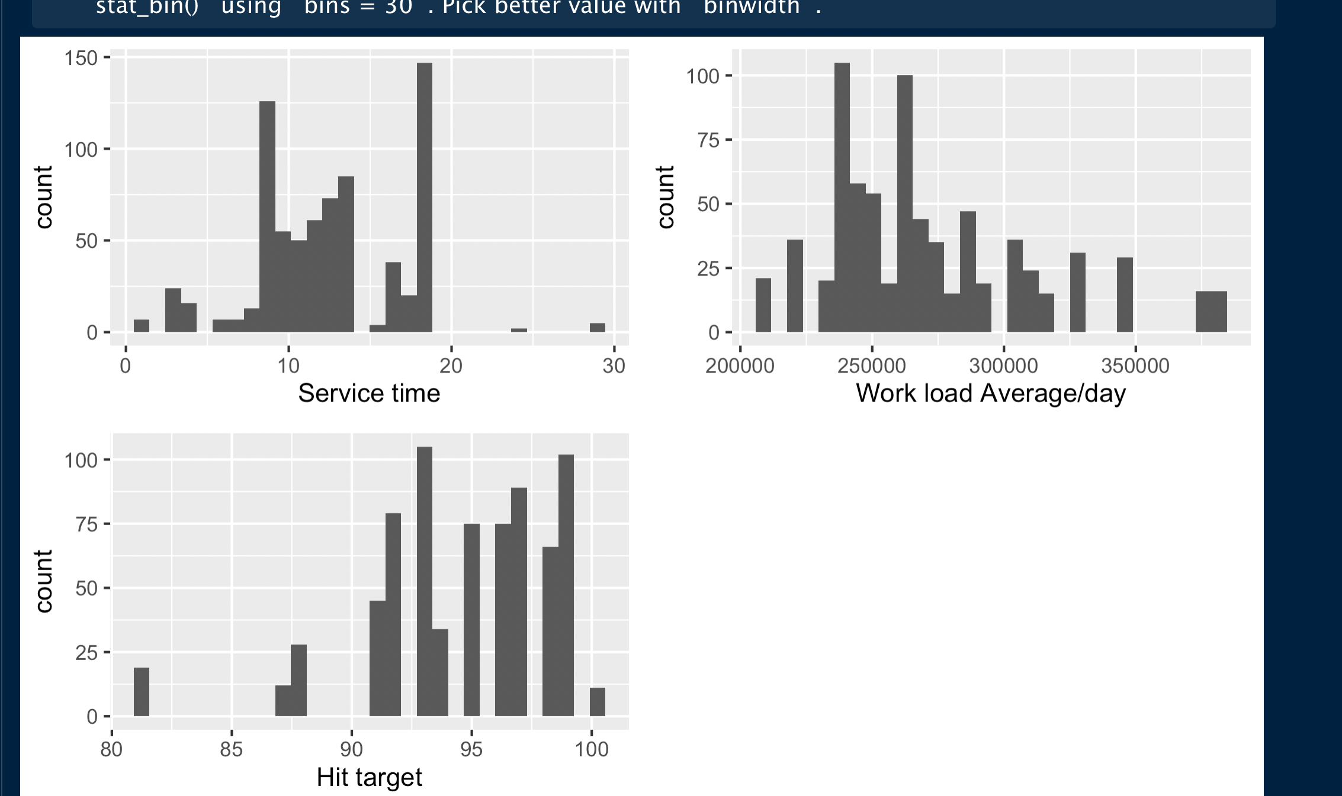
Work information

Slide 33
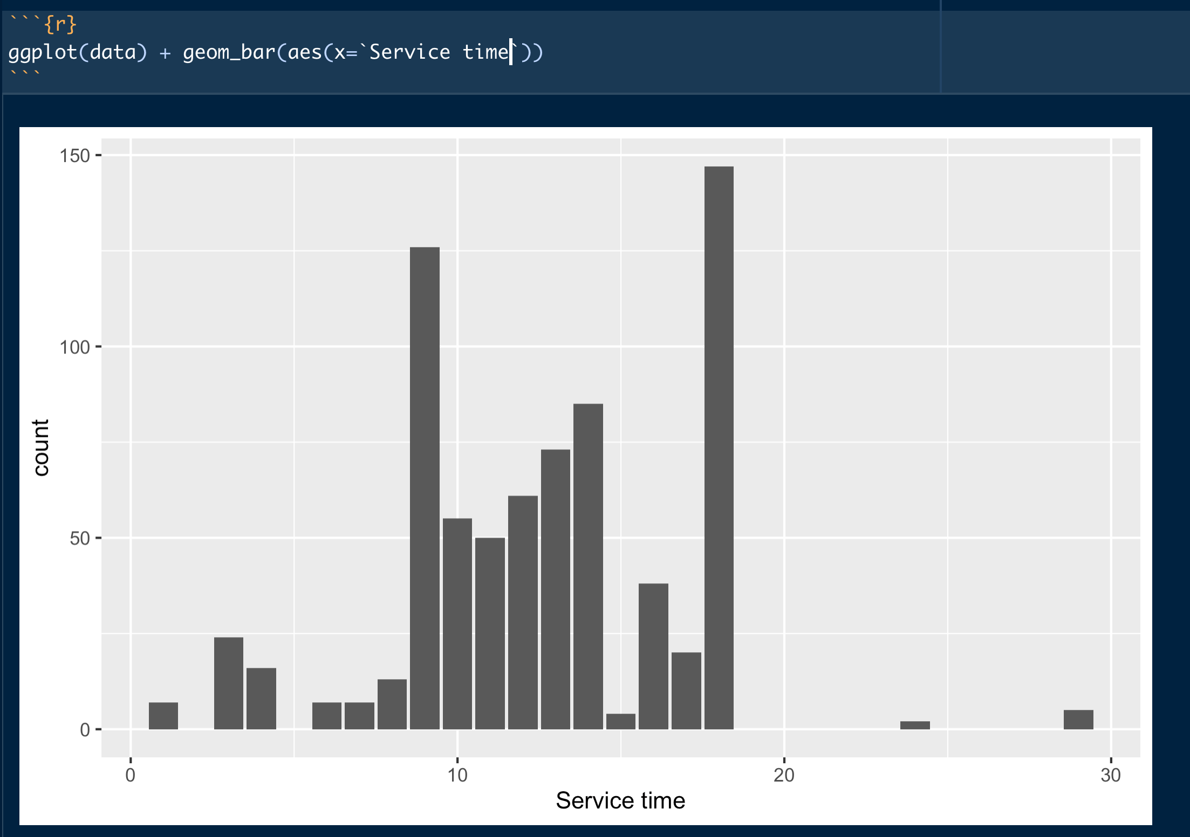

Slide 34
Univariate Summary of numeric –Target

Slide 35
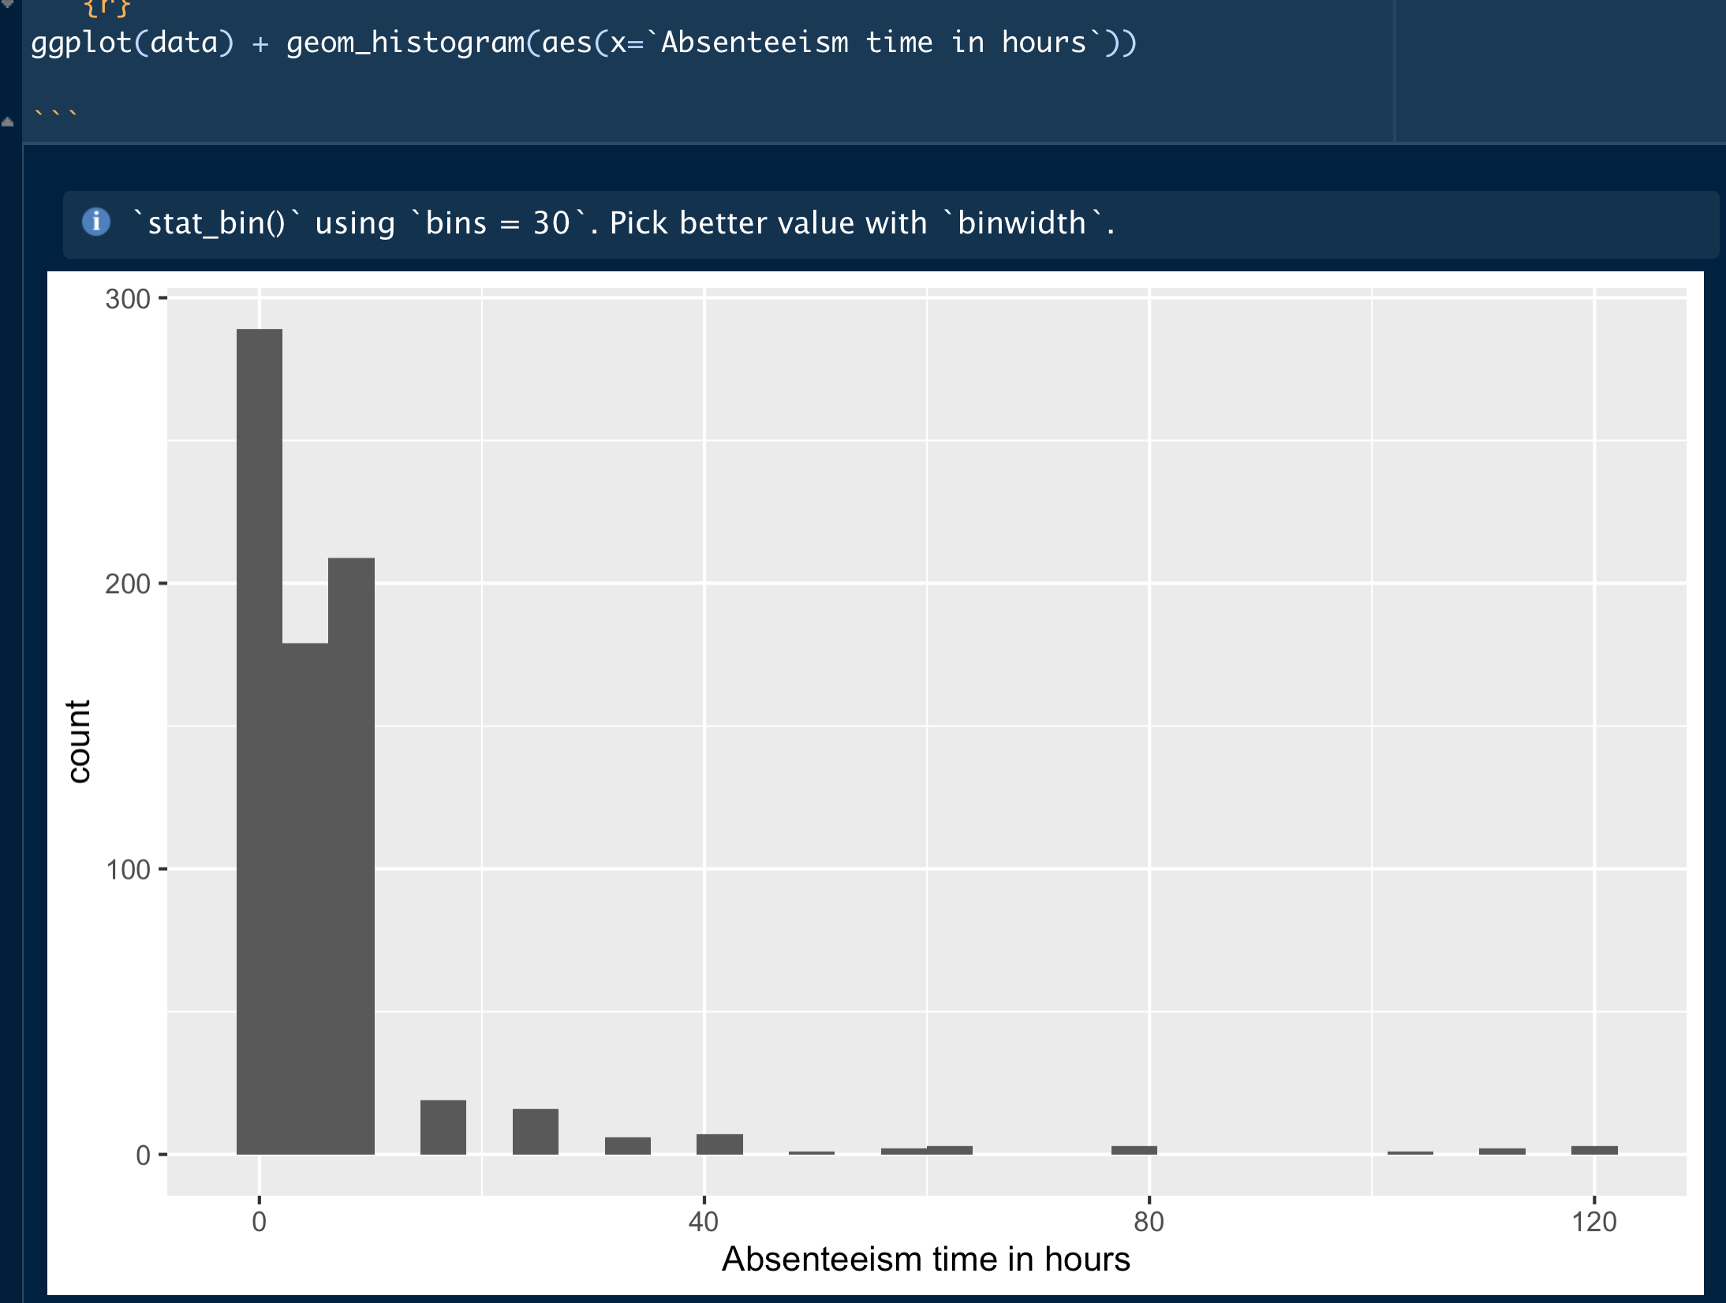

Slide 36
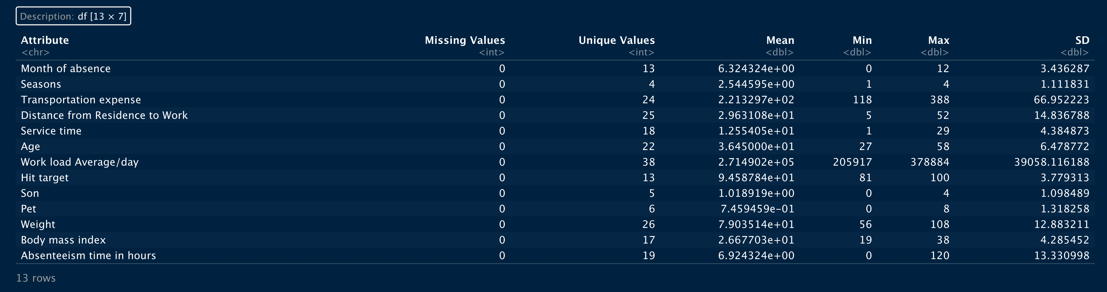
Summary

Slide 37
Bivariate Analysis
Measures vs Measures

Slide 38
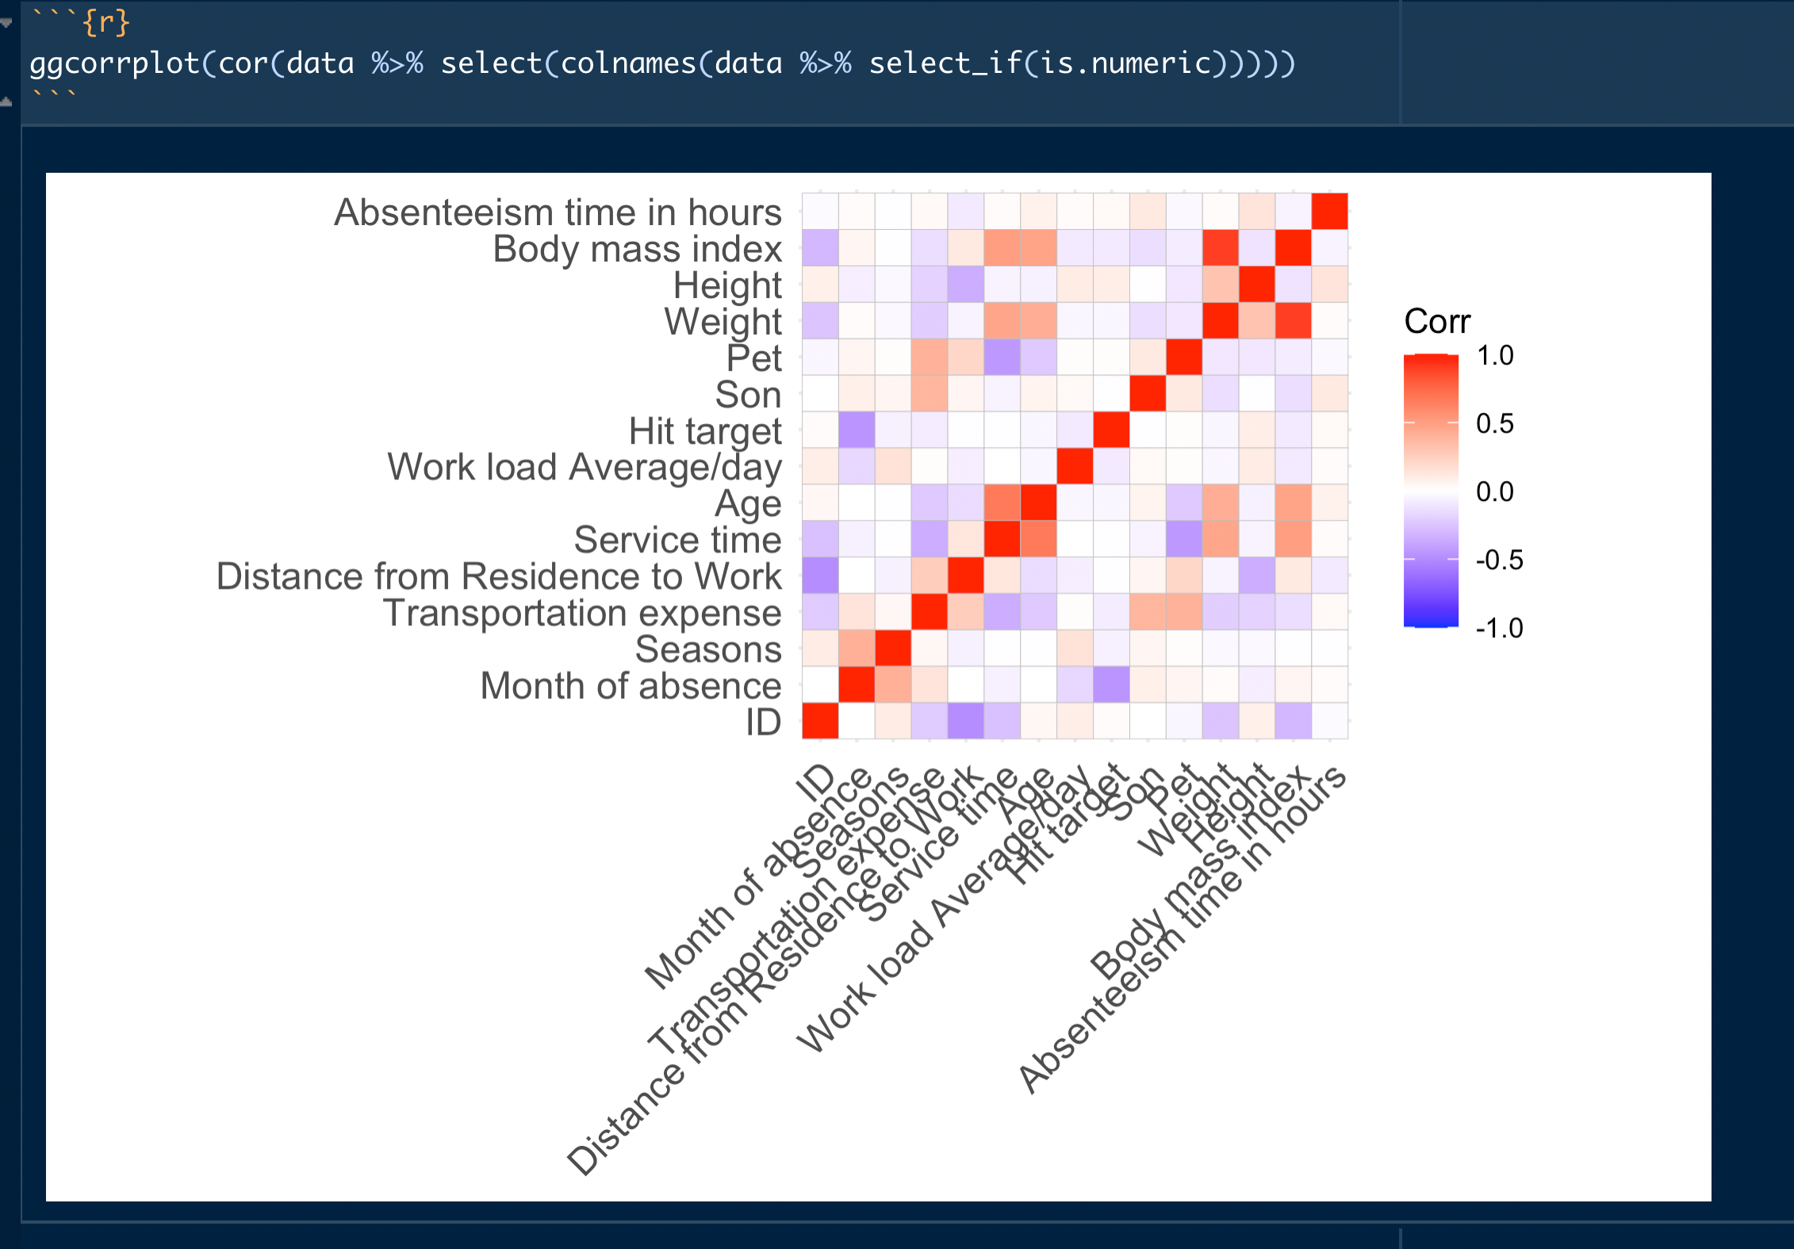
Check the correlation first for the numeric

Slide 39
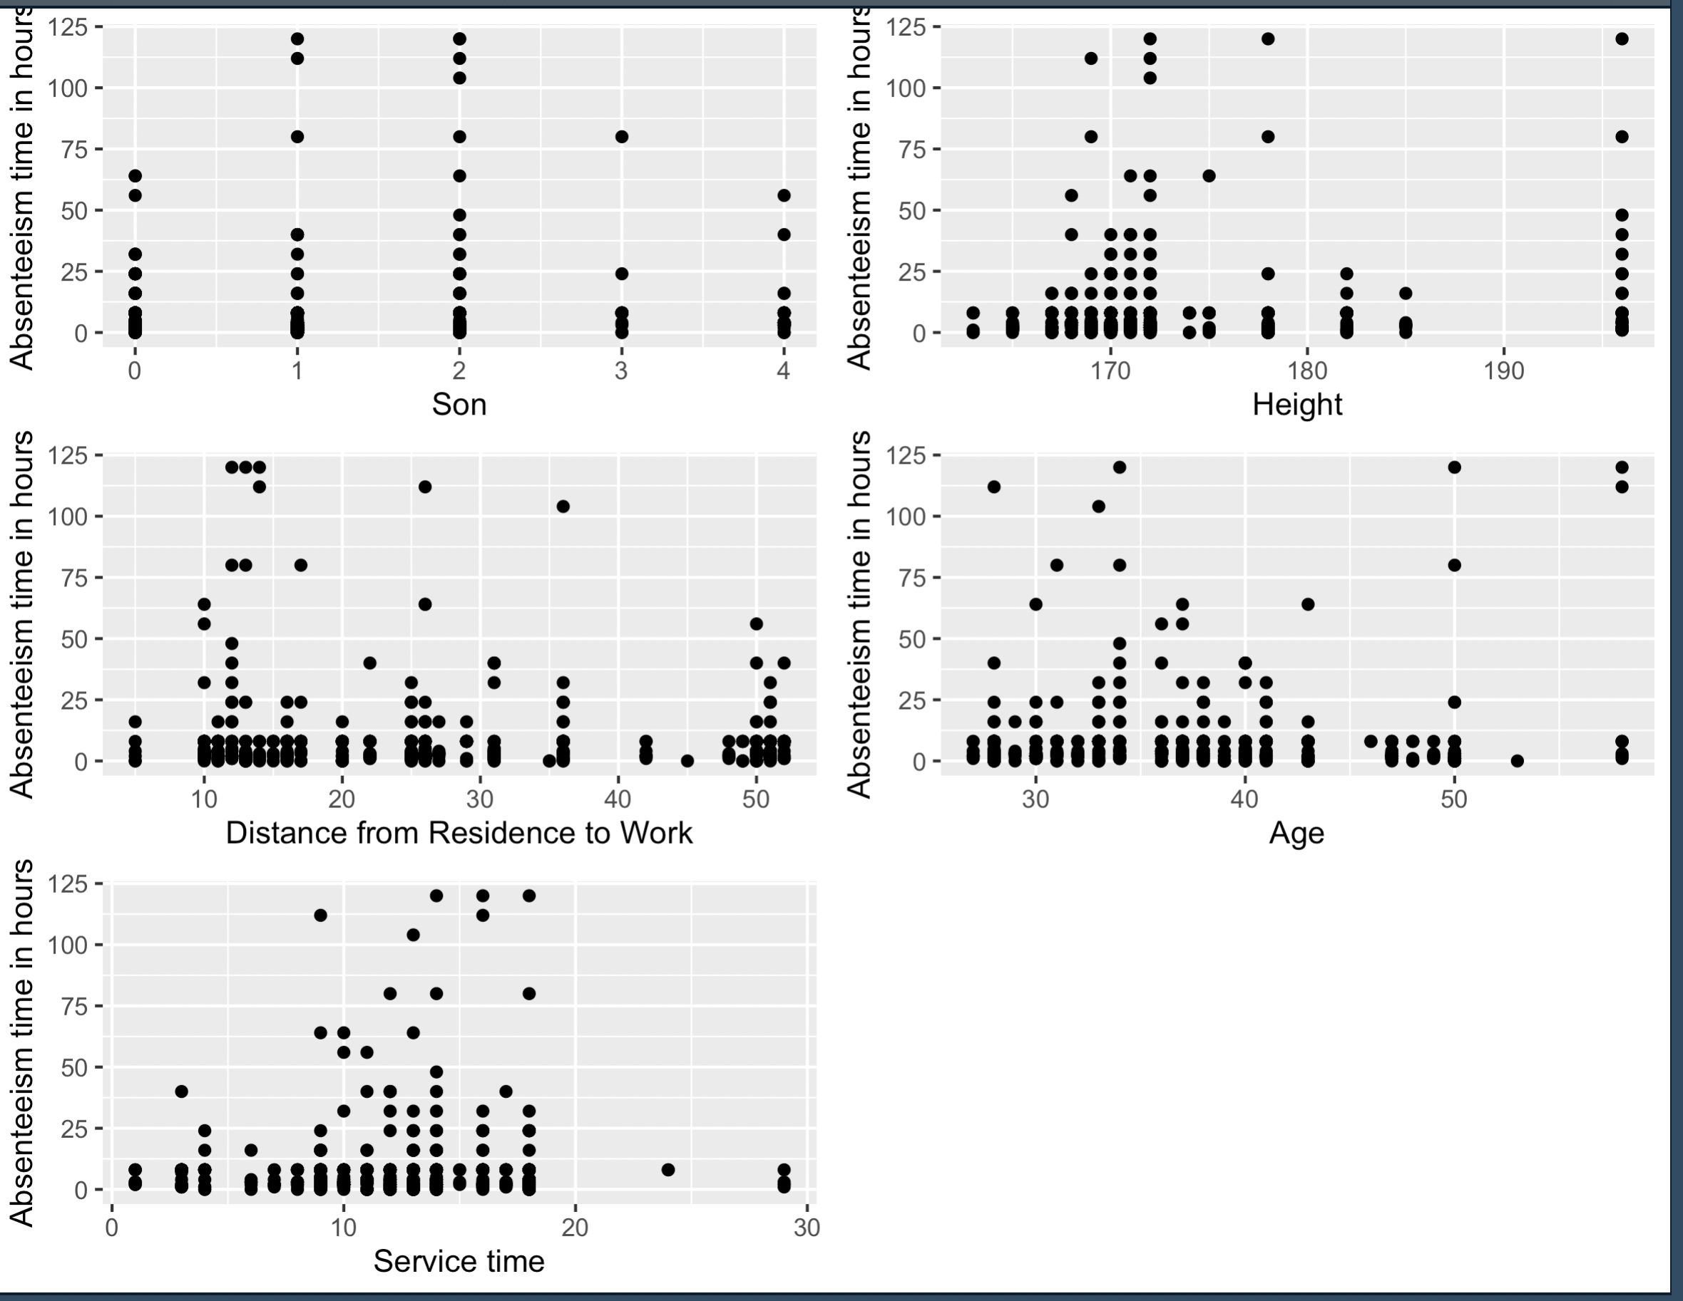
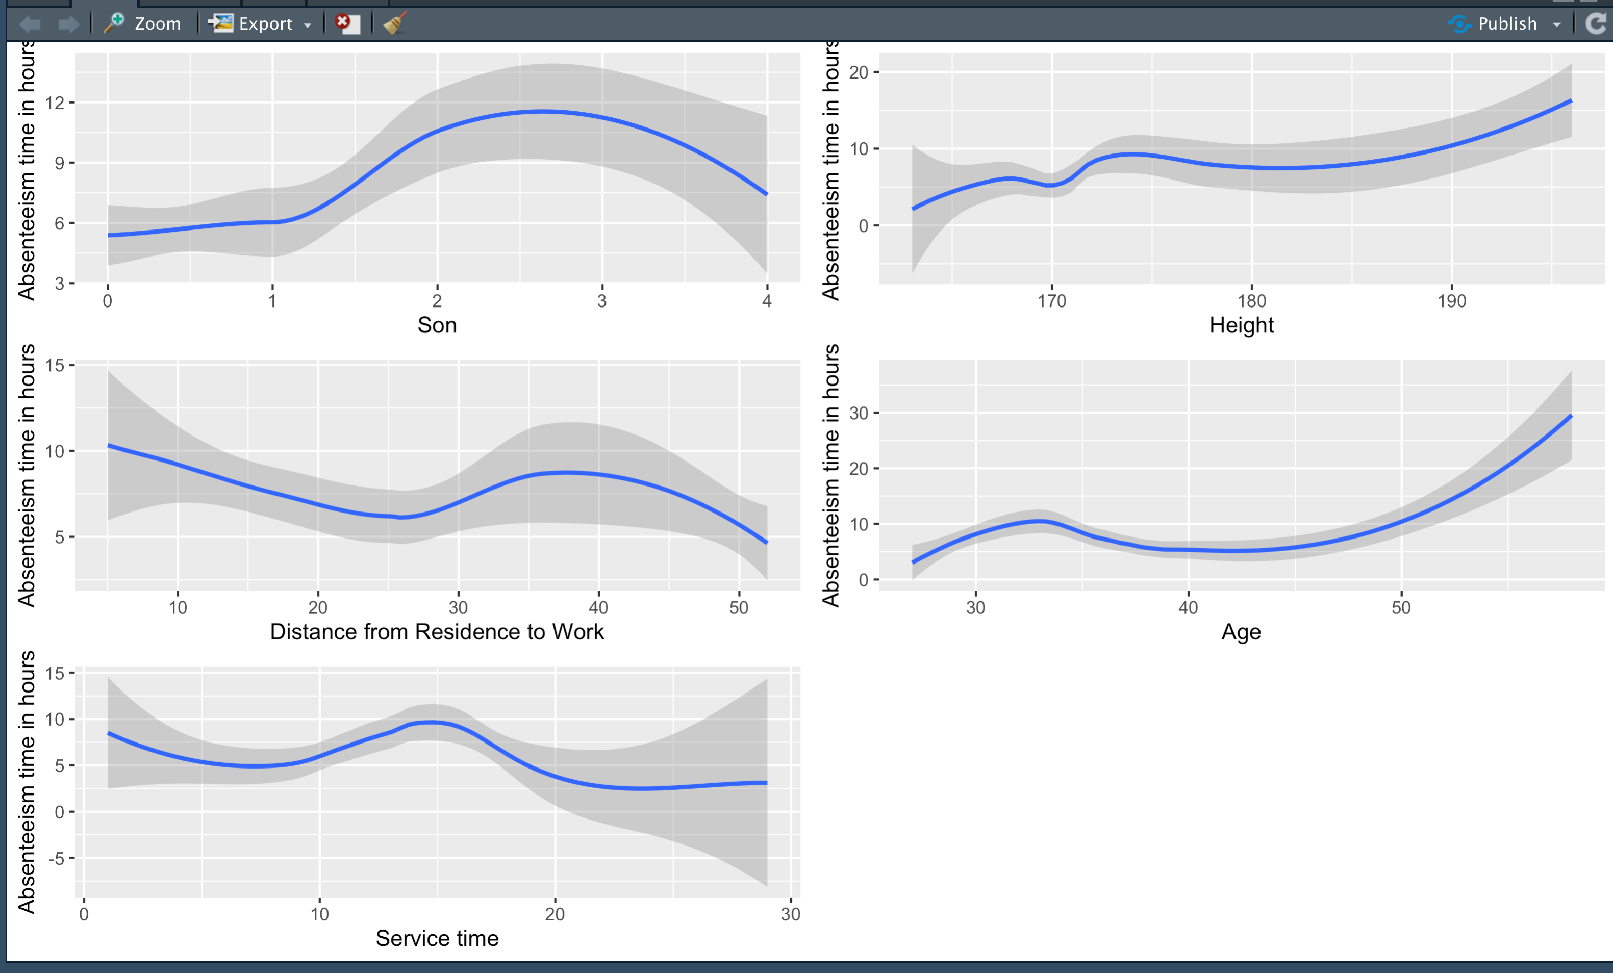
I choose Age, Height, service time, Son, distance from residence to work expense to work to do the measure VS measure

Slide 40
Bivariate Analysis
Categories (factors) vs Measures (numerics)

Slide 41
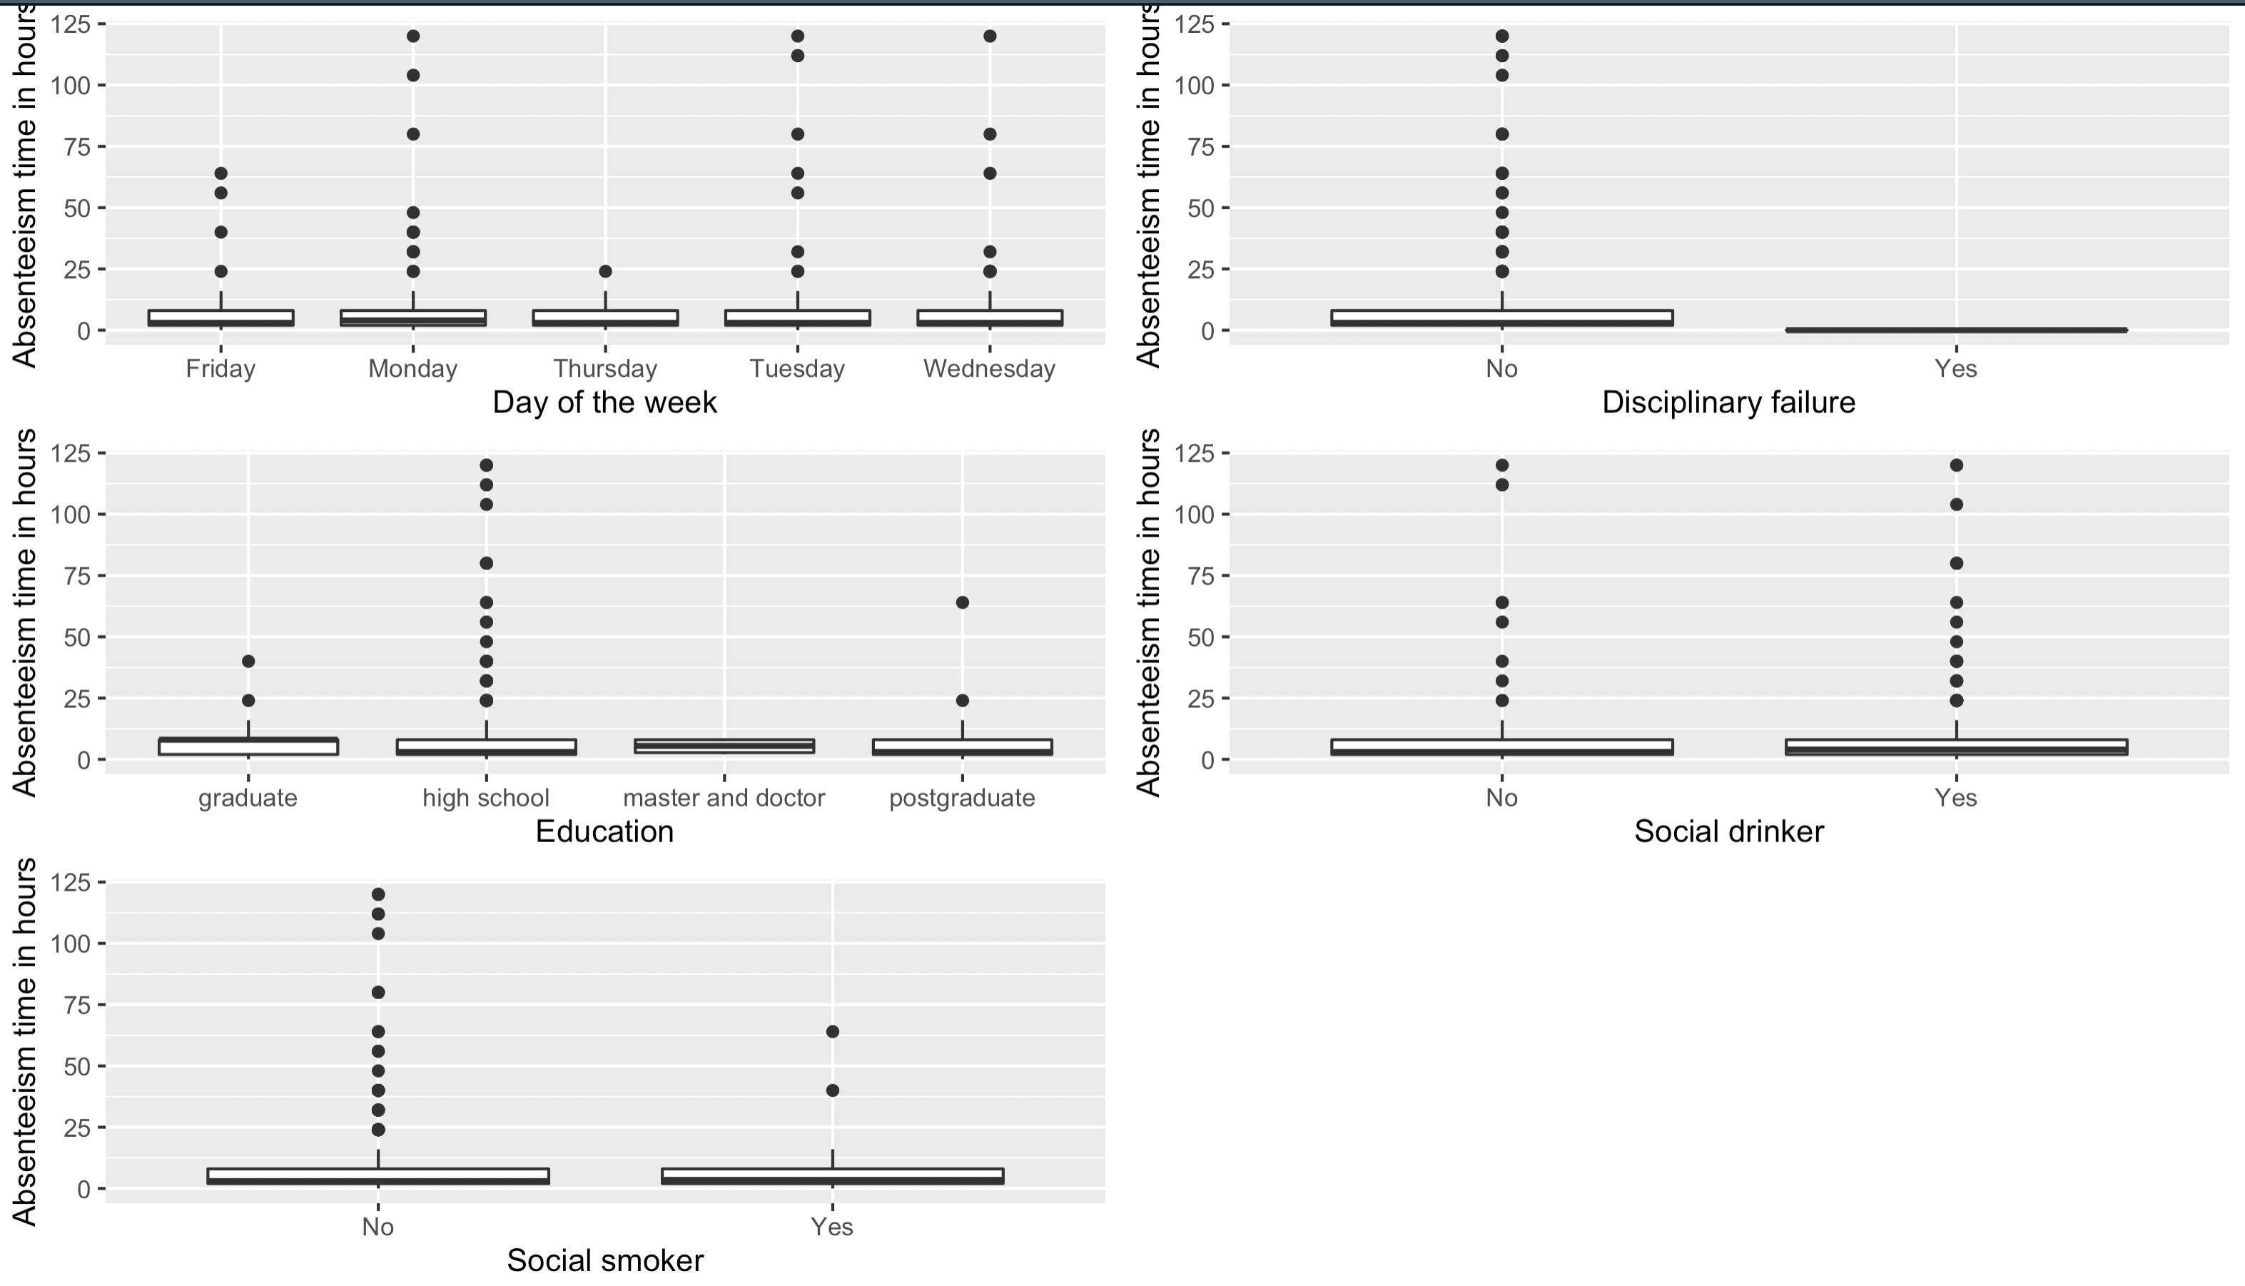
Absenteeism time in work VS ‘Day of the week’, Disciplinary failure’, Education’, ‘Social drinker‘, ‘Social Smoker’

Slide 42
Bivariate Analysis
Categories (factors) vs Categories (factors)

Slide 43
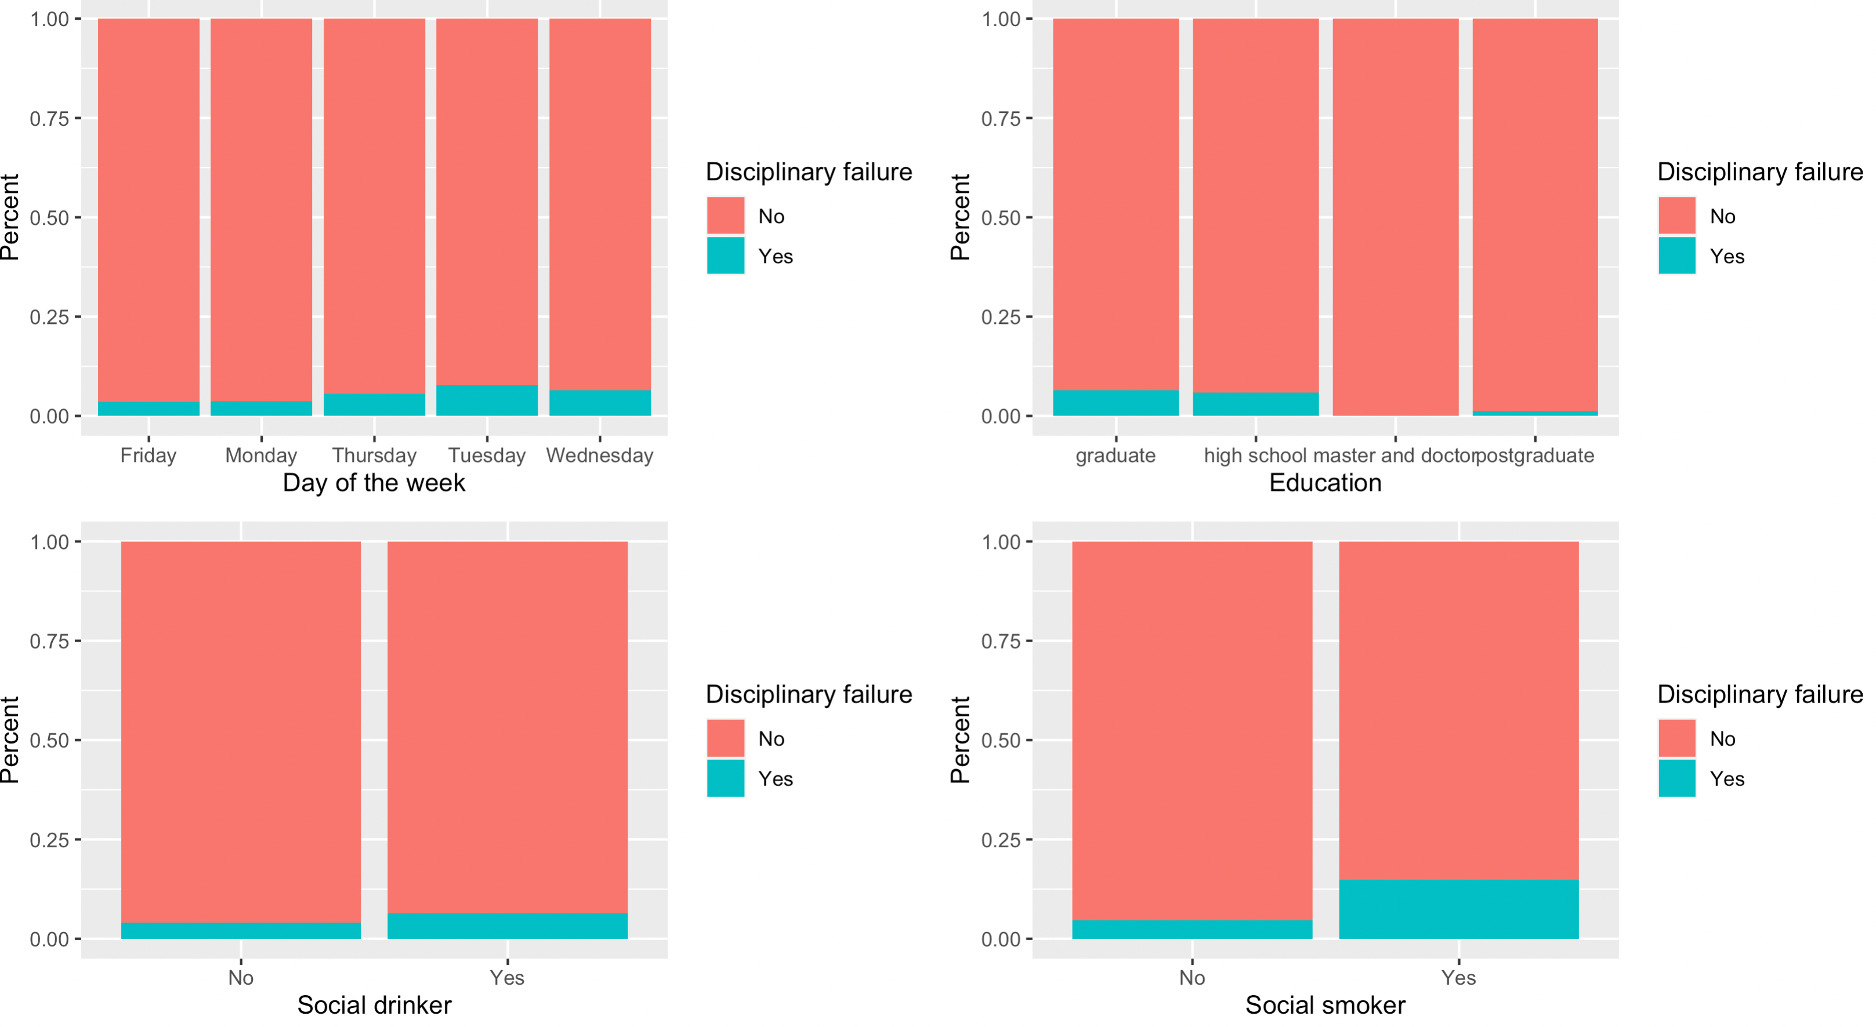
The percent of ‘Day of the week’, ‘Disciplinary failure‘, ‘Social drinker’, ‘Social smoker’

Slide 44
Final Analytic-Ready Data Description
For this database, I am trying to know what kind of person absent for the work. After all the work I did, I found that, age, distance from residence , son, day of week and education have the most effect.
For the education, Hight school employee absent the work the most. For distance from residence, if the employee’s home is far away from the company, the employee will not absent as much as the employee who home is close to the company.
Company could do something to avoid people absent for the work.

Slide 45
Summary of Attributes After Initial Analysis
Logical Groupings of Attributes
Numeric (15)
Absent date: Month of absence, Seasons
Personal information: Age, Son, Pet ,Weight , Height , Body mass index ,ID, Distance from Residence to Work, Transportation expense
Work information: Service time , Hit target , Work load Average/day,
Target: Absenteeism time in hours
Factors (6)
Absent date: Day of the week
Personal information: Social drinker , Social smoker, Education, Disciplinary failure
Reason for absent: Reason for absent

